Slide 1
American & French Revolution
APWH: Beemon

Slide 2
The West by 1750
Enlightenment Thought and Popular Culture
  rational laws could describe social behavior that could be used to improve policies
  Becarria (reduction in harsh punishments – criminologists)
  Adam Smith (economics – Wealth of Nations)
  Diderot – Encyclopedia
  Mary Wollstonecraft – political rights and freedoms should extend to women
  Salons – coffeehouses – reading clubs

Slide 3
First Ten
Analyzing the DOI
Turn to page 168 in your Reilly Reader.
Read the Introduction and Thinking Historically under The American Declaration of Independence.
Next, read the DOI and determine 3 ways in which the DOI is similar to a breakup letter/text.

Slide 4
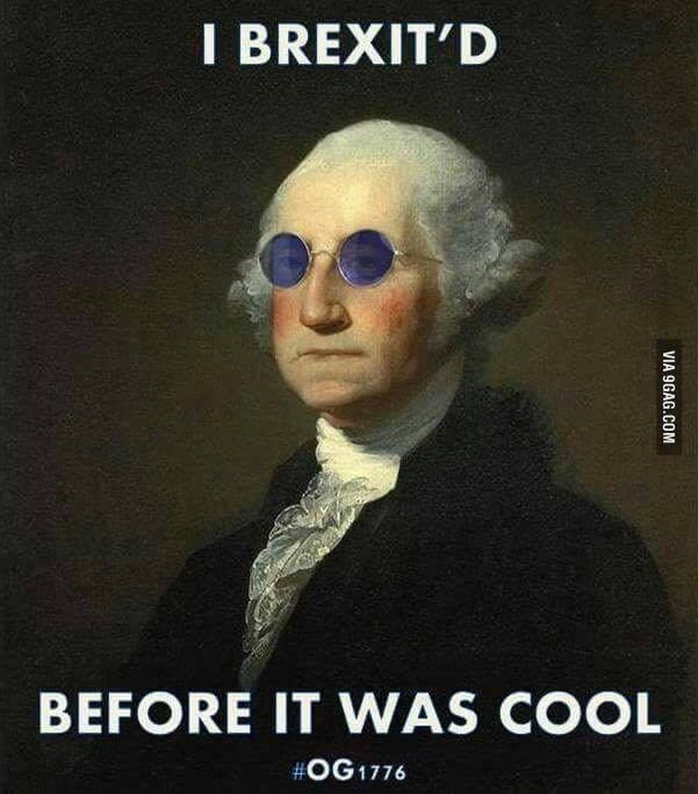
First Ten
Chapter 21 Quiz Date:
  October 31st

Slide 5


Changes in Political Ideologies
Liberal
Conservative
change
tradition

Slide 6
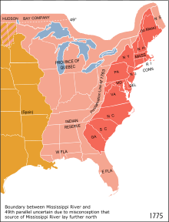
Causes of the American Revolution
French and Indian War (7 yrs War 1754-1763) = debt and NA conflict
Taxation
Proclamation Line of 1763
Violent suppression of protests
  Boston Massacre
  Lexington and Concord
  My Shot
  Guns and Ships
  Yorktown

Slide 7
Events of the American Revolution
1768: First British troops arrive as a result of protests
March 1770: Boston Massacre
May 1773: Tea Act
December 1773: Boston Tea Party
May 1774: Intolerable Acts
September1774: First Continental Congress
April 1775: Lexington and Concord
June 1775: G. Washington appointed
July 1775: Olive Branch Petition
January 1776: T. Paine: Common Sense
July 1776: DOI
October 1777: Saratoga (French aid)
October 1781: Yorktown (GB defeated)
1783: Treaty of Paris 1783

Slide 8
Ramifications of the American Revolution
Do radical actions work?
French Debt
Isolationism under Washington → Jefferson
Inspiration for other countries to overthrow a monarchy

Slide 9
Fun Video Break!
Too Late to Apologize

Slide 10
French Revolution!
Liberté, égalité, fraternité

Slide 11
Causes of the French Revolution
1st Estate
2nd Estate
3rd Estate
Clergy of Roman Catholic Church
Owned 10% of land
Paid 2% of their income into taxes
Provided education and relief services to the poor
Nobility (by birth)
1% of population
2% of population
Owned 20% of land
Paid little to no taxes
Born into nobility – served on Louis’ court
97% of population – 50% of income into taxes
Bourgeoisie – wealthy and educated “middle class” believed in Enlightenment ideas, (bankers, business owners, merchants)
Urban Workers (laborers, apprentices, and domestic servants, artisans)
Peasants – consisted of 80% of population (26 million ppl) worked the land
Unequal social structure w/ tax burden
Poor leadership
Hangry peasants
DEBT

Slide 12
97% of population – 50% of income into taxes
  Bourgeoisie – wealthy and educated “middle class” believed in Enlightenment ideas, (bankers, business owners, merchants)
  Urban Workers (laborers, apprentices, and domestic servants, artisans)
  Peasants – consisted of 80% of population (26 million ppl) worked the land

Slide 13
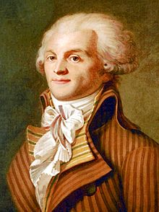
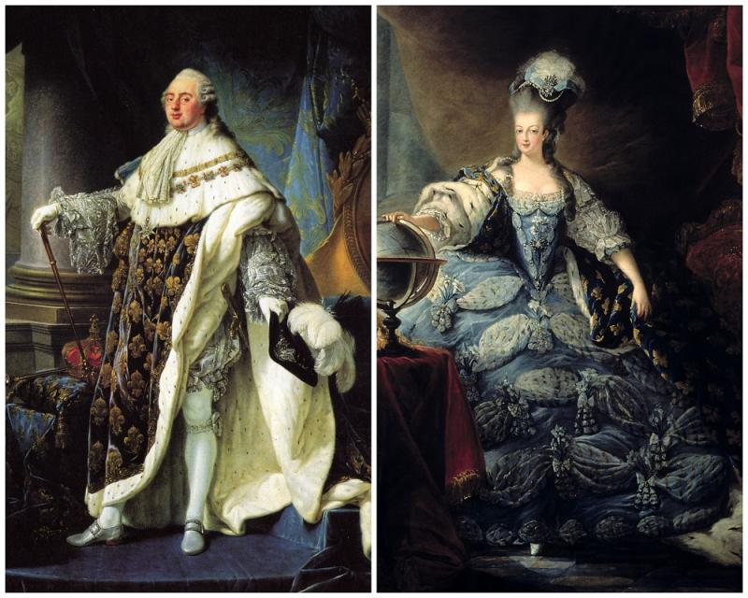
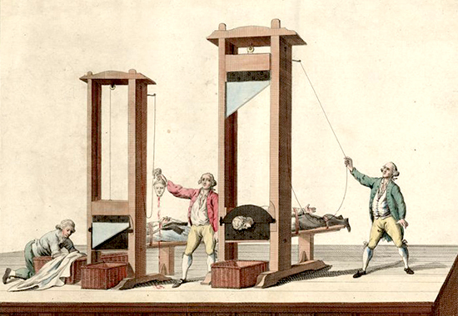
Major events of the French Revolution
May 1789: Call of the Estates General Meeting
June 1789: Tennis Court Oath
July 1789: Storming of the Bastille
August 1789: Declaration of the Rights of Man
October 1789: March on Versailles
June 1791: Attempt to flee by the royal family
January 1793: Execution of the King
September 1793-July 1794: Robespierre and the Reign of Terror
July 1794: Execution of Robespierre

Slide 14
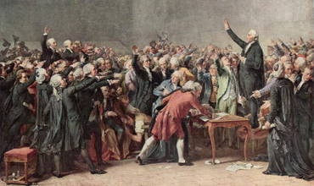
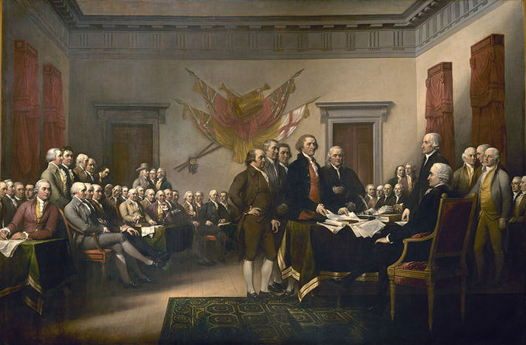

Slide 15
Fun Video break

Slide 16
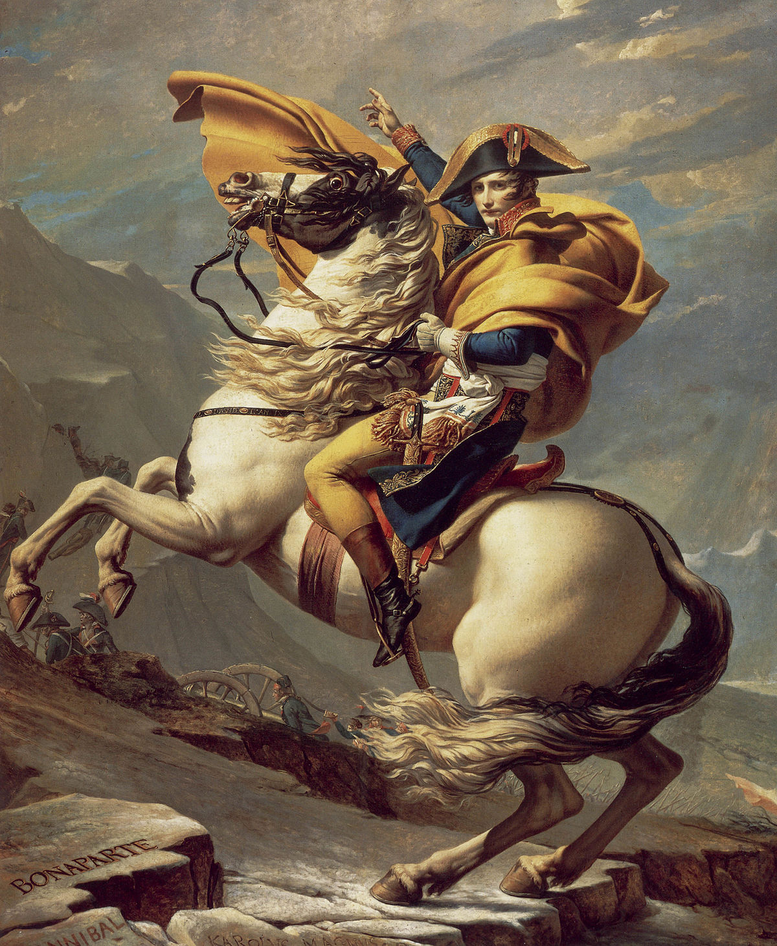
Napoleon Bonaparte
Graduate of Ecole Militaire
Promoted to General of the Army of the West (1795)
Invasion of Egypt (1798)
1799: Coup D’Etat → First Counsel
Reforms:
  Concordat with RCC
  Lycees est.
  Napoleonic Code (First Counsel for life)
  LA Territory
Becomes Emperor (1804)
Downfall:
  Haitian Failure
  CONTINENTAL SYSTEM
  Peninsular War – 1807
  Invasion of Russia – 1812
Exile to Elba – 1814
100 Days – March 1815
Waterloo – June 1815
Exiled to Saint Helena – 1815
coup d'etat

Slide 17
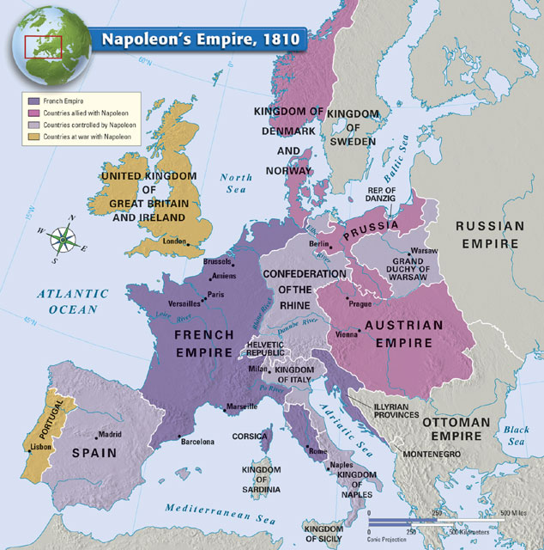

Slide 18
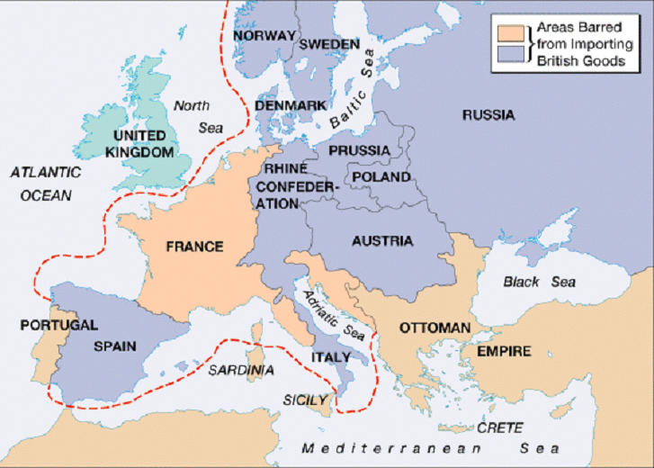

Slide 19
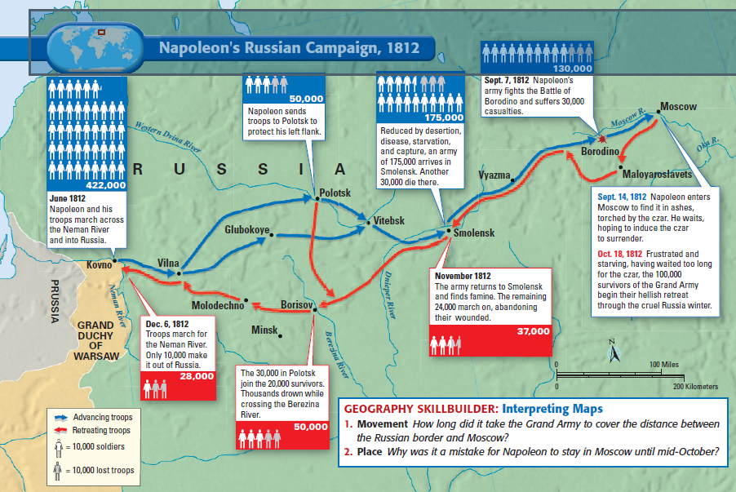

Slide 20
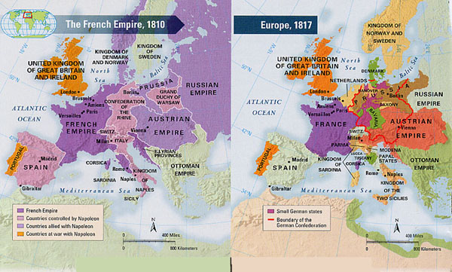
Congress of Vienna
BISMARCK - 1870!

Slide 21
Fun Video break
Napoleon
CCWH: Haiti

Slide 22
Big Ideas! Latin American Revolutions
Causes:
  Prior Revs
  Iberian conflict – Napoleonic Wars
Prior Models of Revs:
  Early revs failed b/c of lack of social unity
  New revs were successful b/c of neglect
  Creoles did not want to follow Haiti or FR
  Difference between US and LA → gov’t of their mother countries, colonized by various countries
Theaters of LA Rev:
  Mexico: Hidalgo and Iturbide – born as a monarchy – central American countries split away
  Northern South America: Bolivar and Gran Columbia
  Southern South America: Jose de San Martin → Rio de la Plata (Argentina, Chile, Peru)
By 1825 all Spanish South America was independent
Brazil: Royal family flees to Brazil in 1807, Rio de Janeiro – Joao VI → Pedro I (1821 – Constitutional Monarchy)

Slide 23
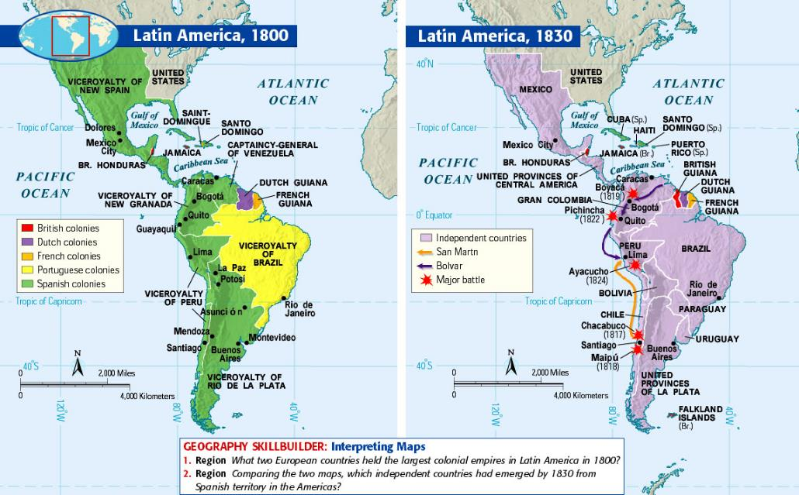

Slide 24
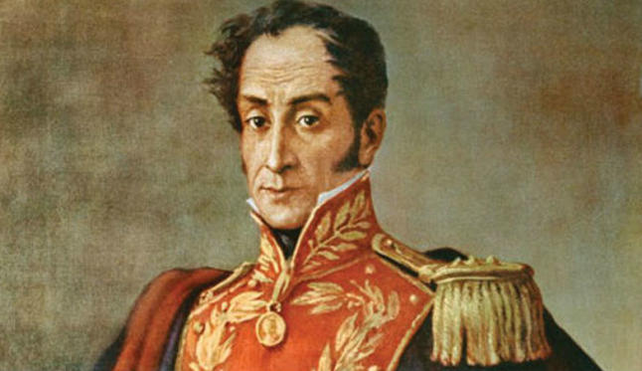
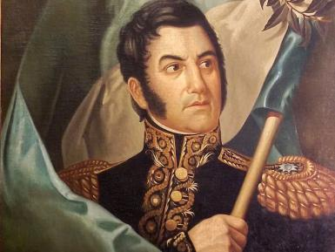
Bolivar and San Martin

Slide 25
Bolivar
Simon Bolivar, the most renowned leader of the Latin American independence movement, was born to a wealthy Venezuelan landowning family in 1783- Orphaned at an early age, he was educated by a private tutor who inspired in his pupil an enthusiasm for the principles of the Enlightenment and republicanism.
After spending three years in Europe, Bolivar returned in 1803 to New Spain, where the death of his new bride plunged him into grief and caused his return to France and Italy. In 1805 in Rome he took a vow to dedicate his life to the liberation of his native land from Spain. On his return he became a leading member of the republican-minded group in Caracas that in 1808 began to agitate for independence and in 1810 deposed the colonial governor. Until his death in 1830, Bolivar dedicated himself to the independence movement as a publicist, diplomat, theoretician, and statesman.
His greatest contribution was as the general who led the armies that defeated the Spaniards and liberated the northern regions of South America. The so-called Jamaica Letter was written in 1815 during a self-imposed exile in Jamaica. It was addressed to "an English gentleman," probably the island's governor, the Duke of Manchester. The Venezuelan Republic had collapsed in May as a result of a viciously fought Spanish counteroffensive, divisions among the revolutionaries, and opposition from many Indians, blacks, and mulattos, who viewed the Creole landowners, not the Spaniards, as their oppressors. The letter was written in response to a request from the Englishman for Bolivar's thoughts about the background and prospects of the liberation movement.

Slide 26
Bolivar’s Letter
The hatred that the Peninsula has inspired in us is greater than the ocean between us.
…we are threatened with the fear of death, dishonor, and every harm; there is nothing we have not suffered at the hands of that unnatural stepmother-Spain.
The chains have been broken; we have been freed, and now our enemies seek to enslave us anew.
But we scarcely retain a vestige of what once was; we are, moreover, neither Indian nor European, but a species midway between the legitimate proprietors of this country and the Spanish usurpers.
We were never viceroys or governors, save in the rarest of instances; seldom archbishops and bishops; diplomats never; as military men, only subordinates; as nobles, without royal privileges. In brief, we were neither magistrates nor financiers and seldom merchants--all in flagrant contradiction to our institutions. …
It is harder, Montesquieu has written, to release a nation from servitude than to enslave a free nation.
As soon as we are strong and under the guidance of a liberal nation which will lend us her protection, we will achieve accord in cultivating the virtues and talents that lead to glory. Then will we march majestically toward that great prosperity for which South America is destined. …

Slide 27
Homework
Quiz Wednesday! FIRST TEN! Over chapter 21 in AMSCO – Revolutions!
Read AMSCO Chapter 24

