Slide 1
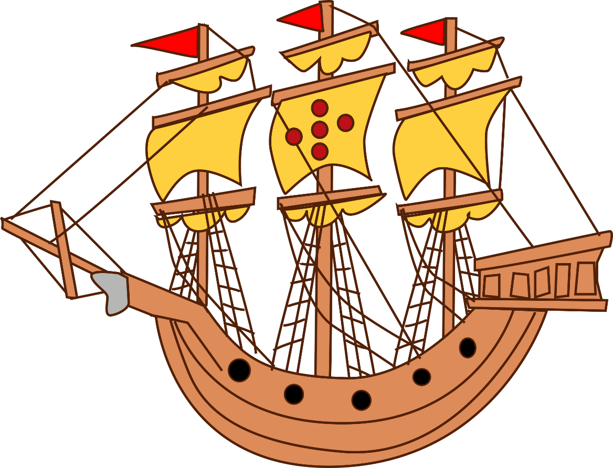
First Ten
What do I know about the Age of Exploration?
Purpose?
People?
Results?

Slide 2
Age of Exploration
1400-1800

Slide 3
Causes of the Age of Exploration
In the 1100’s the Euro. crusaders fought the Muslims for the Holy Land.
  When they returned they brought interesting ideas and items back to W. Euro.
In 1275 Marco Polo reached the palace of Kublai Khan in China. When he returned from Italy he brought Asian/Eastern goods back
Information/goods were also traded through the Silk Roads
The Ren. had encouraged a new spirit of adventure and curiosity.
Mercantilism- act of a country or nation becoming self-sufficient.
GOLD GLORY GOD

Slide 4
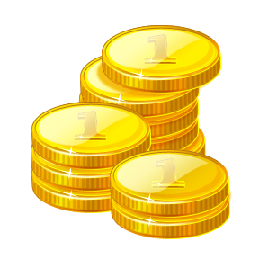

Why go?
The discovery of gold, jewels, could make a quick profit.
The promise of a new life, the hope to own land, & quick riches.
Some went overseas because of persecution or political problems at home. Some wanted to spread their own religion.
And so the call for exploration and expansion was: Gold, Glory, and God

Slide 5
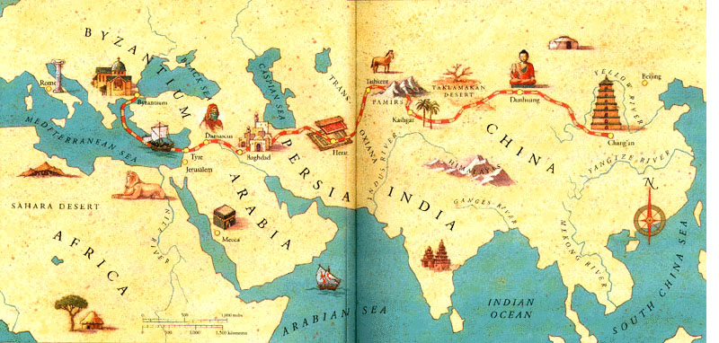
Silk Road

Slide 6
Primary Document – Marco Polo
Marco Polo's Travels
  (1300 A.D.) Latin Book 3, Chapter 4
[The following text led to the discovery of America. These passages, written by Marco Polo, motivated Christopher Columbus to find an alternative route to the Indies. Going Eastward had become almost impossible since the Middle East was occupied by Muslims who would not allow Christians safe passage.]
“It should be understood that the sea in which the Island of Zipangu [Japan] is situated is the sea of CHIN, and so extensive is this eastern sea that according to experienced pilots and mariners, who should know, it contains no fewer than 7,440 islands, mostly inhabited. It is said that every one of the trees which grow in them gives off a fragrant odor. They produce many spices and drugs, particularly aloes, and much pepper, both white and black. It is impossible to estimate the value of gold and other articles found in these islands. Their distance from the continent is so great, and the navigation so difficult, that vessels sailing there do not reap large profits; for they consume a whole year in the voyage.
We shall her treat no further of these countries and islands because of my not having visited them personally and their not being under the dominion of the Great Khan.”

Slide 7

Mercantilism
Political and economic changes led to overseas expansion and new economic theory called
Mercantilism - in order to build economic strength, a nation must export more than it imports.
Establishment of colonies became essential to this competition that grew between European nations
  Provided raw materials
  Source of trade of manufactured goods

Slide 8
EUROPEAN EXPLORATION
One of the main goals - get to Asia in order to acquire spices, silks and jewels.
produced mainly in India, China and the islands of E. & S.E. Asia.
Europeans needed advanced technology to get there

Slide 9
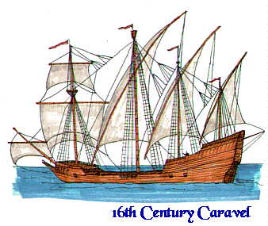
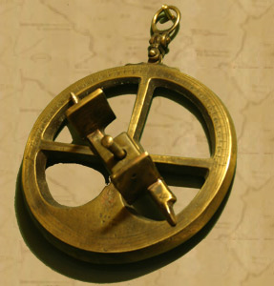
Technology Advancements
Caravel
  Sturdy AND sails effectively
  triangular shaped sail – sail against wind
  Cannon/handguns
Astrolabe
  Brass circle with degrees
  Calculated latitude
  allowed ppl. to sail far out to sea rather than staying close to the coastline.
Compass
  Invention from China
http://fc.lbpsb.qc.ca/~history/caravl.jpg
http://members.shaw.ca/michaeljmcgrath/astrolabe.jpg

Slide 10
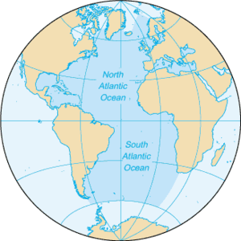
Why Spain & Portugal?
Geography plays a part….
Your thoughts?

Slide 11
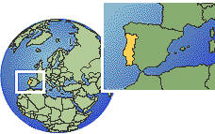
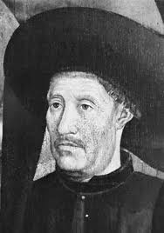
Portugal
Portugal -1st interested in exploration.
Prince Henry was nicknamed Henry the Navigator. He had 3 main goals for Portugal:
  1. New lands and peoples for Christianity by a crusade in Africa.
  2. Desire to acquire a share of the African slave trade that the Muslims controlled.
  3. He wanted to start trading with Asia.
Early 1400’s Prince Henry founded a school
  $$$$ - navigators / captains began a series of explorations westward into the Atlantic and southward to Africa

Slide 12
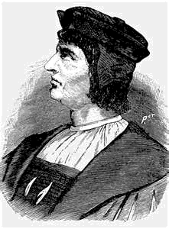
Portugal Cont.
1488- Bartholomew Dias sailed around the Cape of Good Hope, at the southern tip of Africa.
In 1498, Vasco da Gama sailed around Africa and across the Indian Ocean and returned with riches from Asia.
This discovery made it possible for Portuguese traders to bring goods directly to Europe cheaper than dealing with the Arab traders. - Cut the middle man

Slide 13
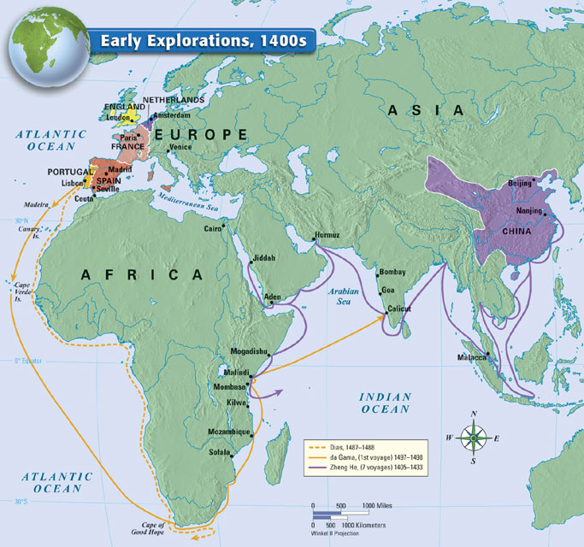

Slide 14
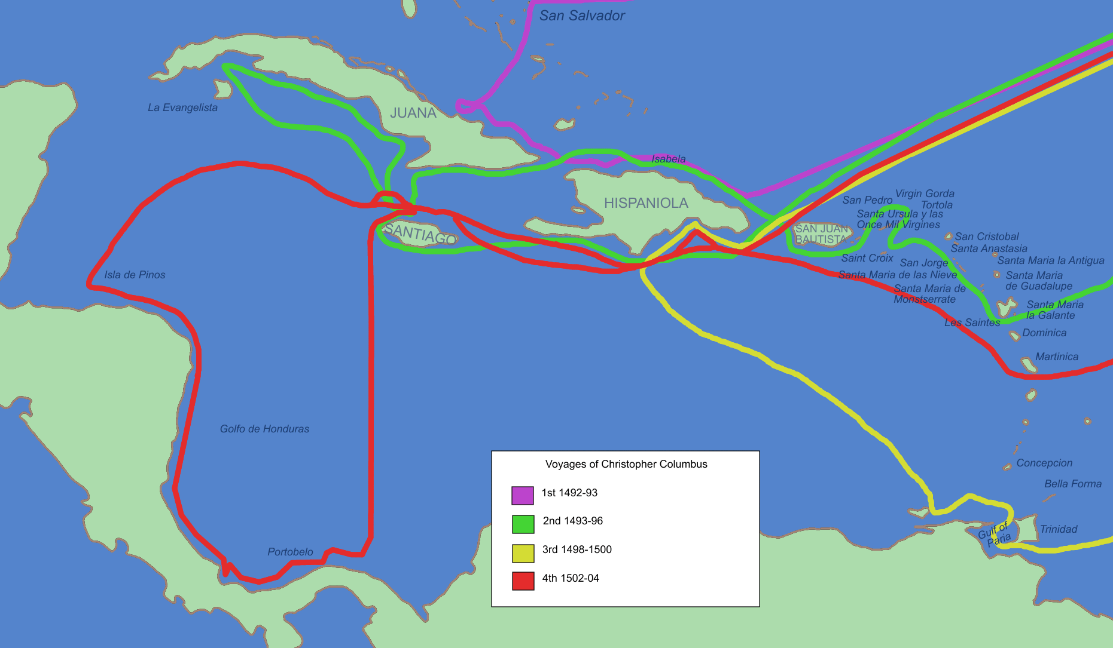
Spain
Spain interest in exploring. - Jealous of Portugal.
Ferdinand and Isabella, decided to finance
Christopher Columbus an Italian navigator.
Columbus thought the world was much smaller than it actually is, and so he thought he could reach India quickly and easily by sailing west.
In August of 1492, he left Spain with three ships and crossed the Atlantic.
In October he landed on the island of San Salvador (near Cuba).
  Columbus thought an island off the coast of India
  called the people Indians.

Slide 15
Columbus
As a result these islands will later be called the West Indies.
In the spring of 1493 Columbus returned to Spain to report his discoveries.
He made 3 more voyages between 1493 and 1504, and he died believing he had found lands there were near or a part of Asia.

Slide 16
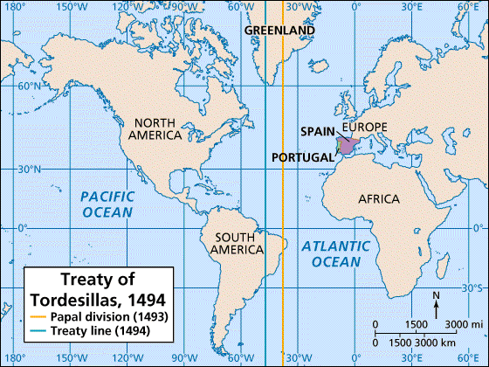
Treaty of Tordesillas
Spain and Portugal each claimed many new lands & claimed the same lands.
1493/4
Pope initiates the comp.
Btwn. Spain and Portugal
Line of Demarcation
  West = Spain
  East = Portugal
http://go.hrw.com/venus_images/0320MC15.gif

Slide 17
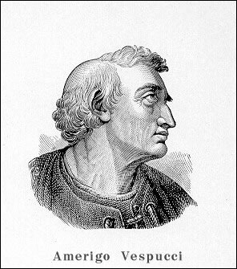
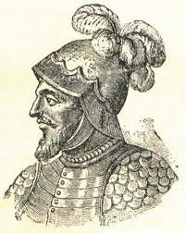
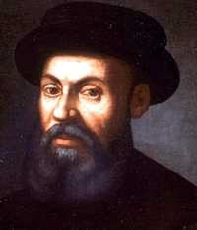
Other Explorers
Amerigo Vespucci
  Realized the land that Columbus landed on was NOT India, but a new land. The mapmaker will name the new land after Amerigo (America)
Vasco Nunez de Balboa
  First European to see the Pacific Ocean – named it the South Sea
Ferdinand Magellan
  His crew was the first to circumnavigate (circle) the world – He did not make it ☹

Slide 18
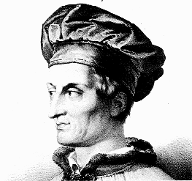
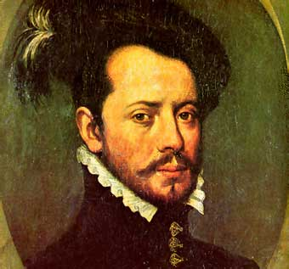
Spain Builds an American Empire
Conquistadors: Conquerors-Cortes and his men conquer C. America-Aztecs. (1519)
Pizarro conquers Inca 15 yrs. Later.
Spain: Central America (Mexico) → mestizo
Portugal: Brazil (sugar)
http://www.vrcurassow.com/2dvrc/discovery/vespucci1b.GIF
http://www.biografiasyvidas.com/biografia/c/fotos/cortes.jpg

