Slide 1
Unit Eight Cold War to Modern Era
World History
Beemon
SSWH19-21
http://www.history.com/videos/cold-war#cold-war

Slide 2
SSWH19 The student will demonstrate an understanding of the global social, economic, and political impact of the Cold War and decolonization from 1945 to 1989.
a. Analyze the revolutionary movements in India (Gandhi, Nehru), China (Mao Zedong, Chiang Kai-shek), and Ghana (Kwame Nkrumah).
b. Describe the formation of the state of Israel and the importance of geography in its development.
c. Explain the arms race; include development of the hydrogen bomb (1954) and SALT (Strategic Arms Limitation Treaty, 1972).
d. Compare and contrast the reforms of Khrushchev and Gorbachev.
e. Analyze efforts in the pursuit of freedom; include anti-apartheid, Tiananmen Square, and the fall of the Berlin Wall.

Slide 3
First Ten
We are starting a new topic today! We are moving into the modern era with the Cold War.
The Cold War lasted from 1945-1989/91.
Tell me what you know!
Why is it called the “cold war”?
What happened in 1945, 1989, and 1991 for historians to consider these the start and stop dates?

Slide 4
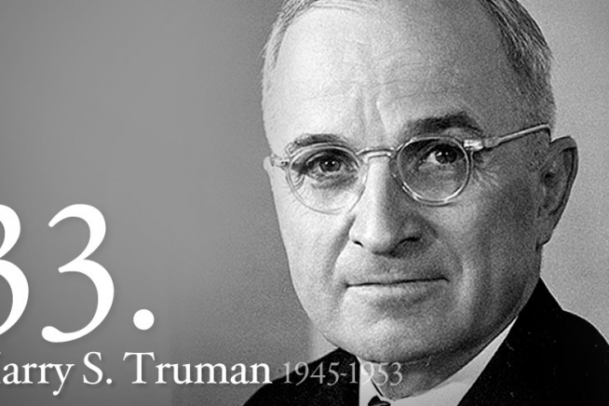
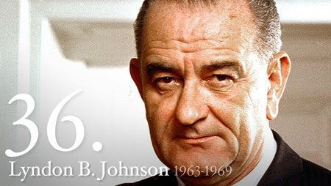
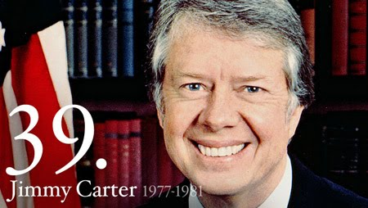
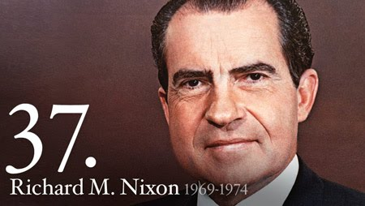
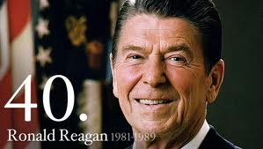
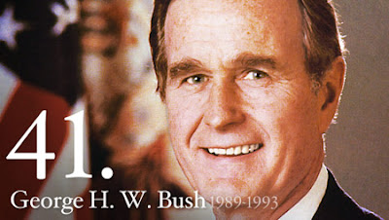
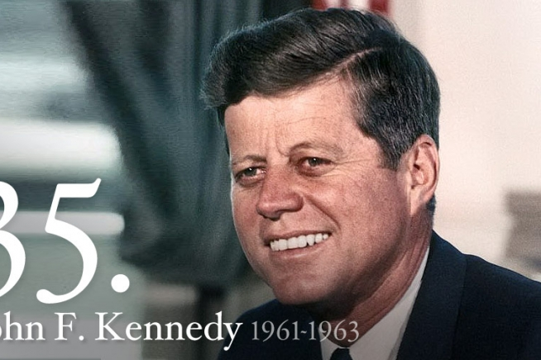
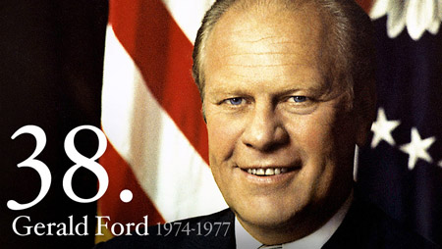

Slide 5
United Nations
The UN was founded in 1945 to replace the League of Nations, to stop wars between nations and to provide a platform for dialogue.

Slide 6
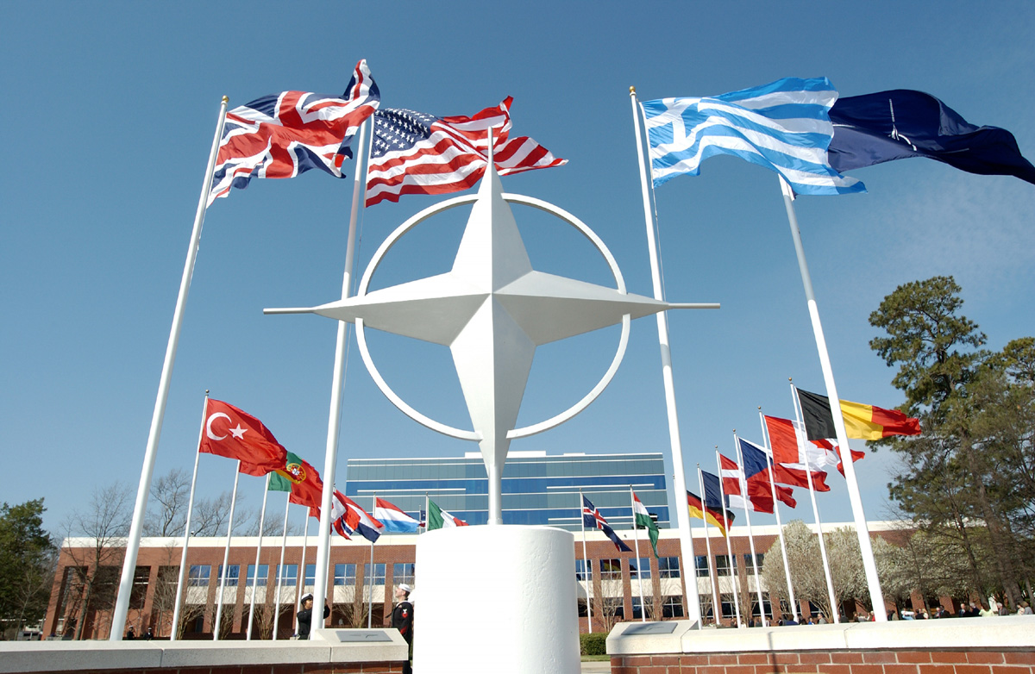
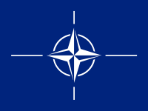
NATO
North Atlantic Treaty Organization
Formed in 1949
Western European countries (Netherlands, Luxembourg, FR, GB, Portugal, IT, Norway, Denmark, Iceland, Greece, and Turkey), US, and Canada
Support one another if attacked

Slide 7
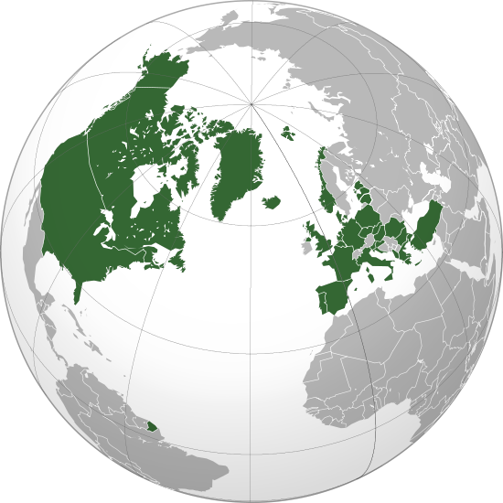
NATO MEMBERS

Slide 8
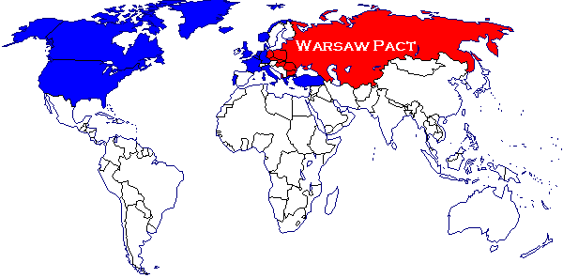
Warsaw Pact
Formed in opposition of NATO
1955
Albania, Bulgaria, Czech., E. GM, Hungary, Poland, Romania, and Soviet Union

Slide 9
Troops :
NATO 2.6 million
Warsaw Pact 4 million
Tanks :
NATO 13,000
Warsaw Pact 42,500
Artillery :
NATO 10,750
Warsaw Pact 31,500

Slide 10
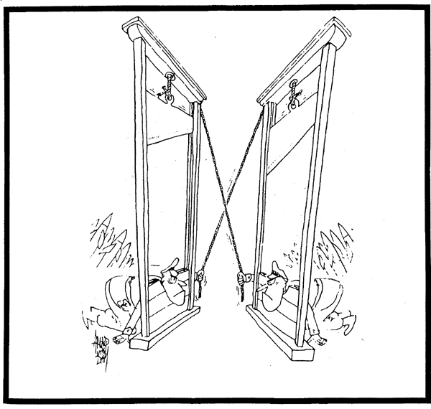
MAD
During the 1960’s the theory of MAD developed - Mutually Assured Destruction. This meant that if SU attacked the west, the west would make sure that they would suitably retaliate i.e. there would be no winners.
By 1981, USA had 8,000 ICBM’s & SU had 7,000 ICBM’s

Slide 11
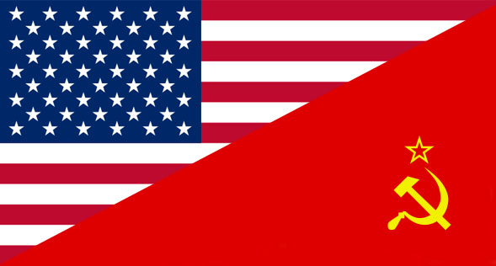
Cold War Basics
1949-1991
Soviet Union (SU) vs. United States (US)
Communism vs. Capitalism (Democracy)
Cold War – struggle over political differences carried on by means short of military action or war.
Had been allies in WWII but had different ideas for the world after the war was over.
Continuing conflict over:
Natural resources in Europe
Creation of markets in Europe (US), but the SU wanted to protect its boarders in E. Europe
US wants GM united and SU wants it separate to prevent another war
Did not just affect the US and the SU
2 physical wars fought within the war
Korea and Vietnam

Slide 12
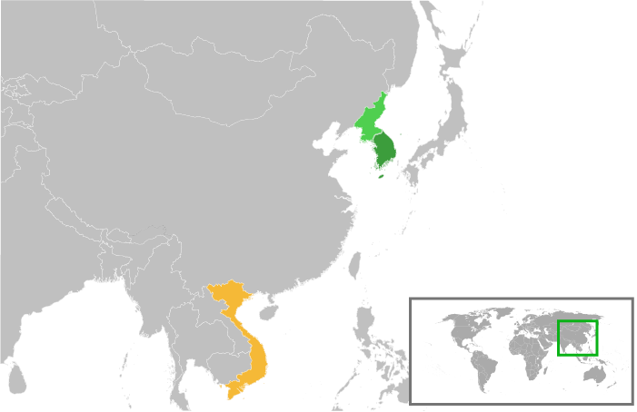

Slide 13
Activity
Arms Race/Space Race Reading
Start Video

Slide 14
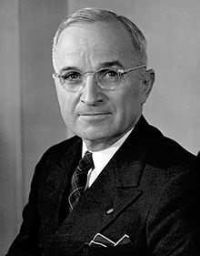
Cold War Begins
FDR dies and Truman takes over the Cold War for the US.
Both agree that Communism and Democracy cannot coexist
Churchill claims that an “iron curtain” has descended across the European continent.
Democratic West and Communist East
Truman Doctrine – commitment to help ($$$) ANY country wanting to resist communism after WWII

Slide 15
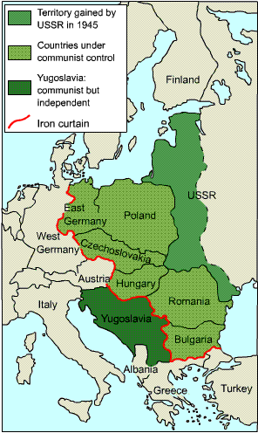
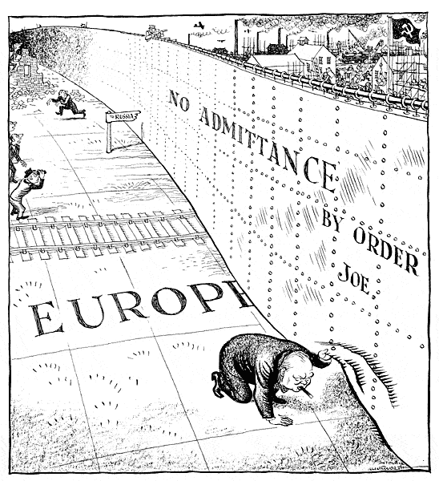
Iron Curtain

Slide 16
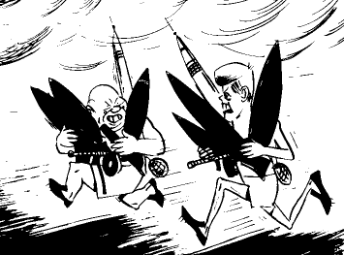
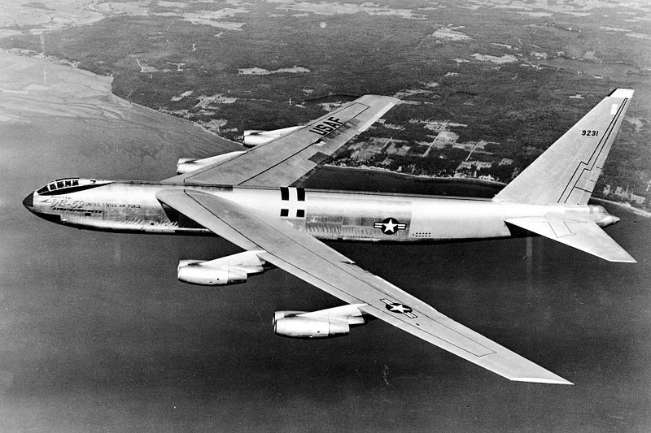
Arms Race
The nuclear arms race was central to the Cold War. Many feared the Cold War belief that the more nuclear weapons you had, the more powerful you were. Both the SU and the US built stockpiles of nuclear weapons
US exploded the H-bomb in 1952. This one bomb was smaller in size than the Hiroshima atomic bomb but 2500 times more powerful. The SU produced an H-bomb in 1953
US produced a bomber - the B52 - that could fly 6,000 miles and deliver a nuclear pay-load

Slide 17
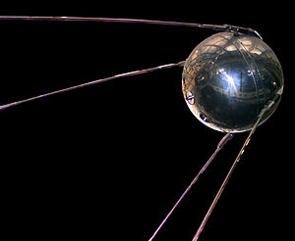
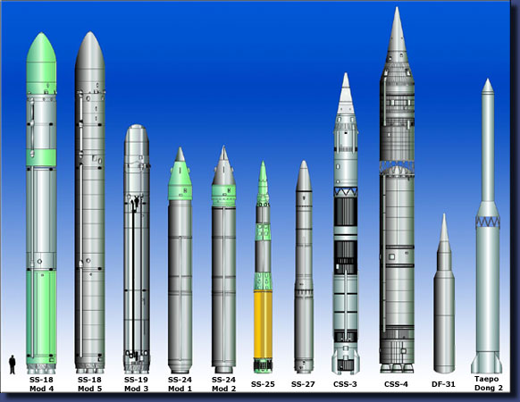
Arms Race Cont.
In October 1957, the world was introduced to the fear of a missile attack when Sputnik was launched. (First satellite into space – by SU)
This was to lead to ICBM’s : Inter-Continental Ballistic Missiles. Could launch a missile using satellites (Think GPS systems) Could hit a direct coordinate on the map.
As a result, America built the DEW line around the Artic - Defense and Early Warning system.
At the end of the 1950’s, American Intelligence estimated that in a Soviet missile attack, 20 million Americans would die and 22 million would be injured.
Emphasis was put on new weapon systems - mobile missile launchers were built, missiles were housed underground in silos and in 1960 the first Polaris submarine was launched carrying 16 nuclear missiles. Each missile carried four warheads; so one submarine effectively carried 64 nuclear warheads.

Slide 18
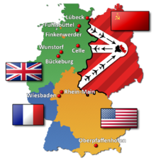
Berlin
GM and Berlin are both divided after WWII.
Berlin (capital) is in the Soviet sector
Berlin Air Lift: Soviets wanted western Berlin also. Cut off water, rail and highway traffic. Starve them out – US; UK flew in food and supplies 11months May 1949
Berlin Wall will eventually divide East and West Berlin – constructed in 1961
It is dismantled in 1989 and symbolically represented an end to the Cold War
133- 200 people were confirmed killed trying to cross the Wall into West Berlin. The GDR/East German government gave orders to shoot and kill attempted defectors. The East German gov’t had always denied having such a policy.

Slide 19
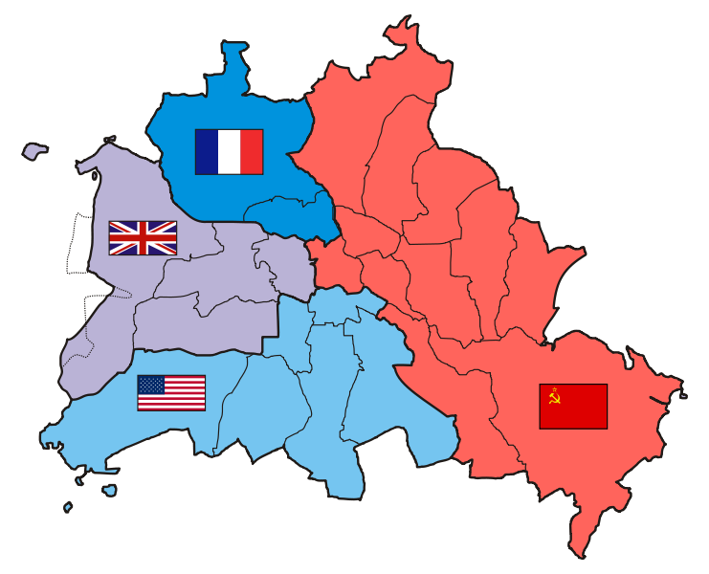
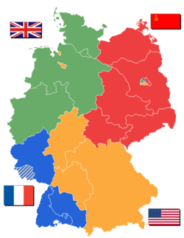
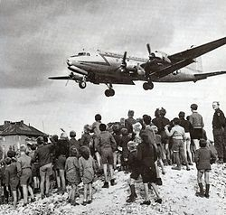

Slide 20
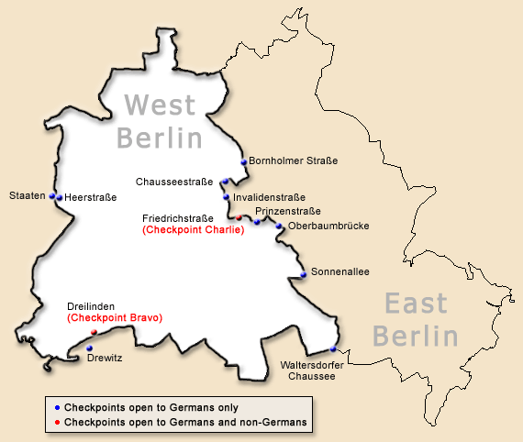
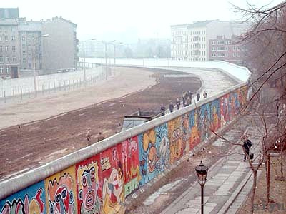
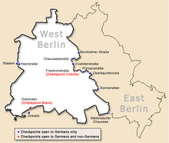

Slide 21
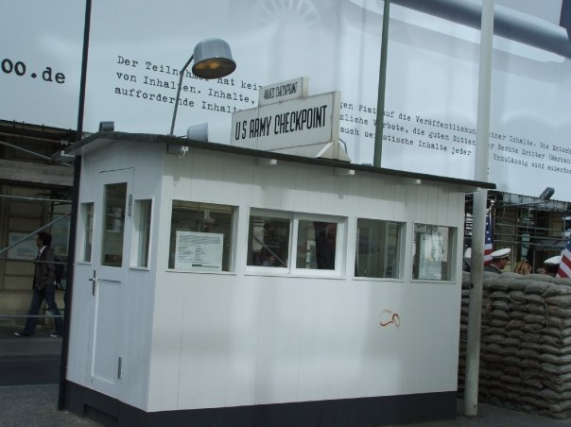
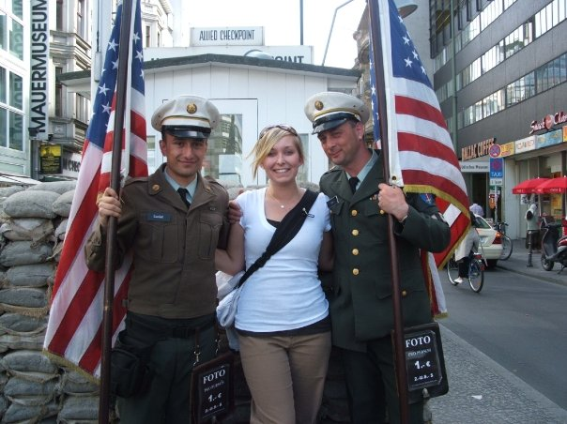

Slide 22
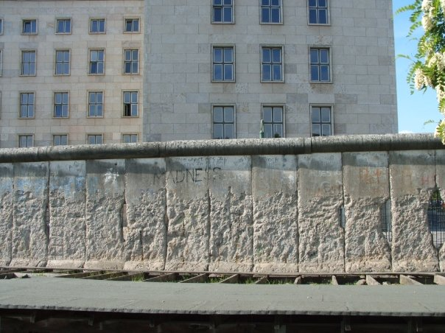

Slide 23
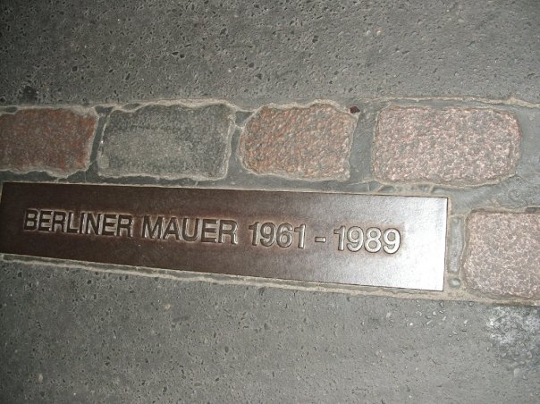

Slide 24
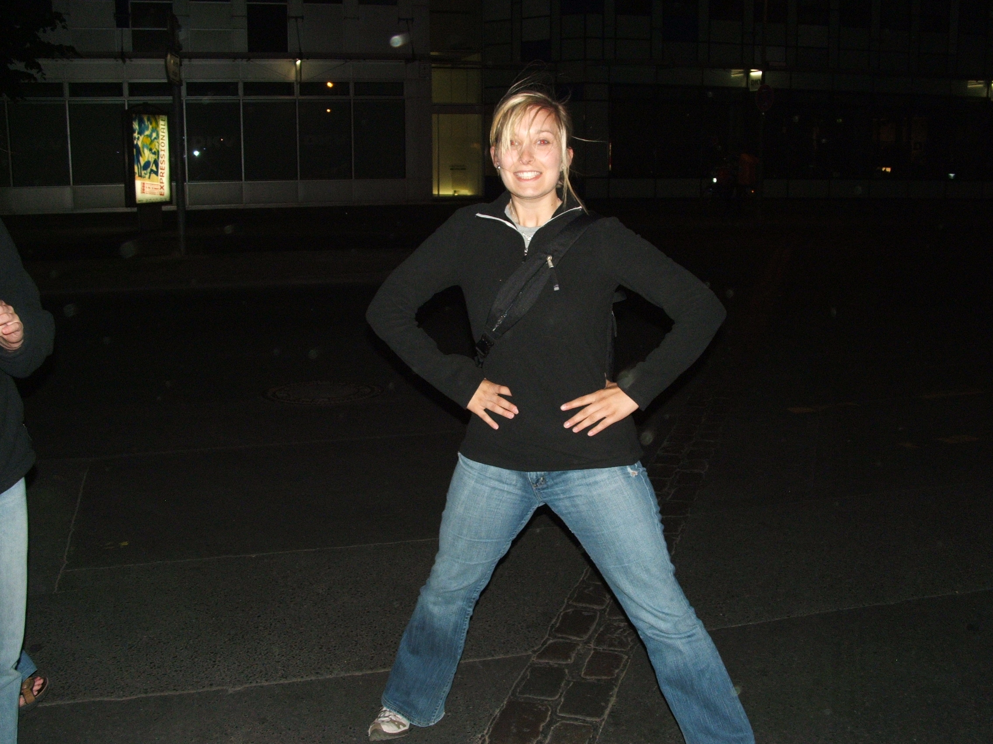

Slide 25
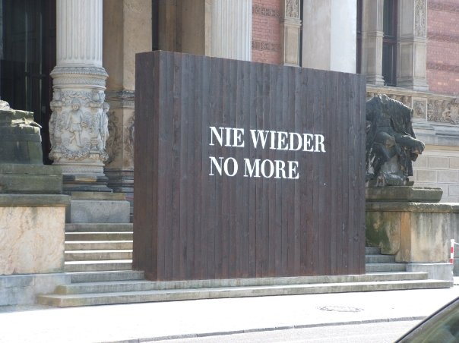

Slide 26
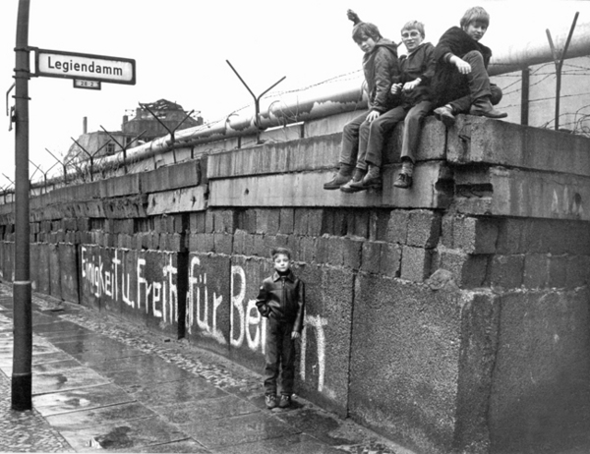

Slide 27
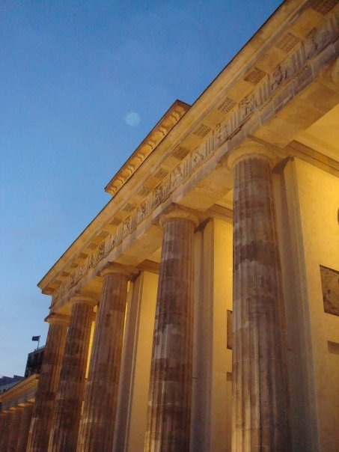

Slide 28
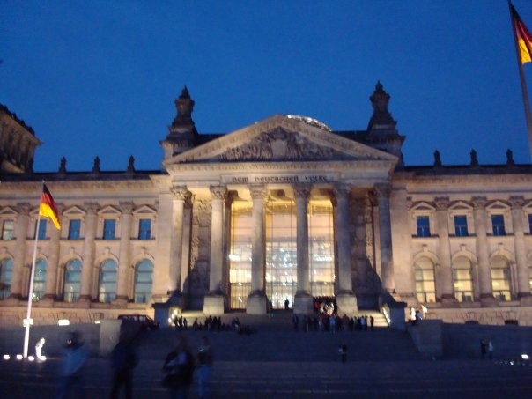

Slide 29
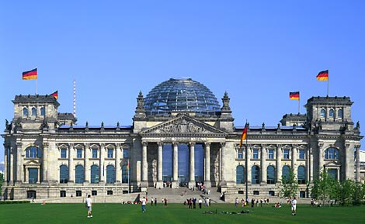

Slide 30
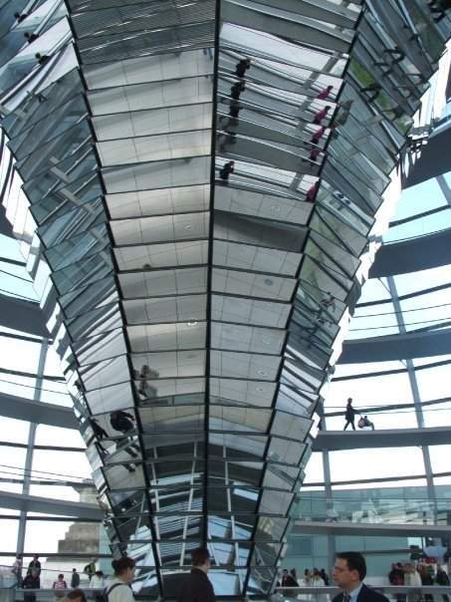
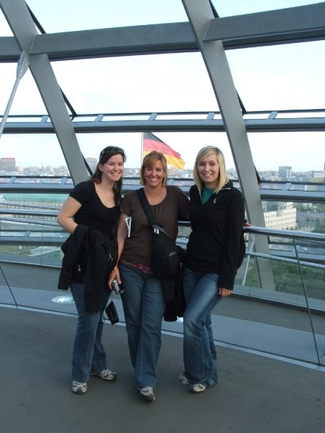

Slide 31
First Ten
How did the Arms Race impact global security issues?
How did the Space Race impact the relationship between the Soviet Union and the United States?
What was the policy of containment and what was trying to be contained?
MAD
NATO
ICBM
Your week at a glance:
Monday: Finish Cold War Notes
Tuesday: Review Day!
Wednesday: No Class (1st and 2nd blocks only)
Thursday: Final Exam – Units 1-7

Slide 32
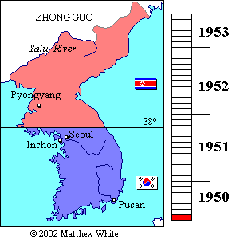
Korean War
After WWII the SU occupied Northern region of Korea and the US occupied the Southern region
1950-1953
Divided at the 38th parallel
North Korea wants to unite, so they launch attacks on democratic South.
Douglas MacArthur led the Southern forces against the North. He is eventually dismissed by Truman after he attempts to push north into China.
War ended in a stalemate and the North remained separate from the South at the 38th parallel. It is still divided today and North Korea is Communist and South Korea is a Democracy.

Slide 33
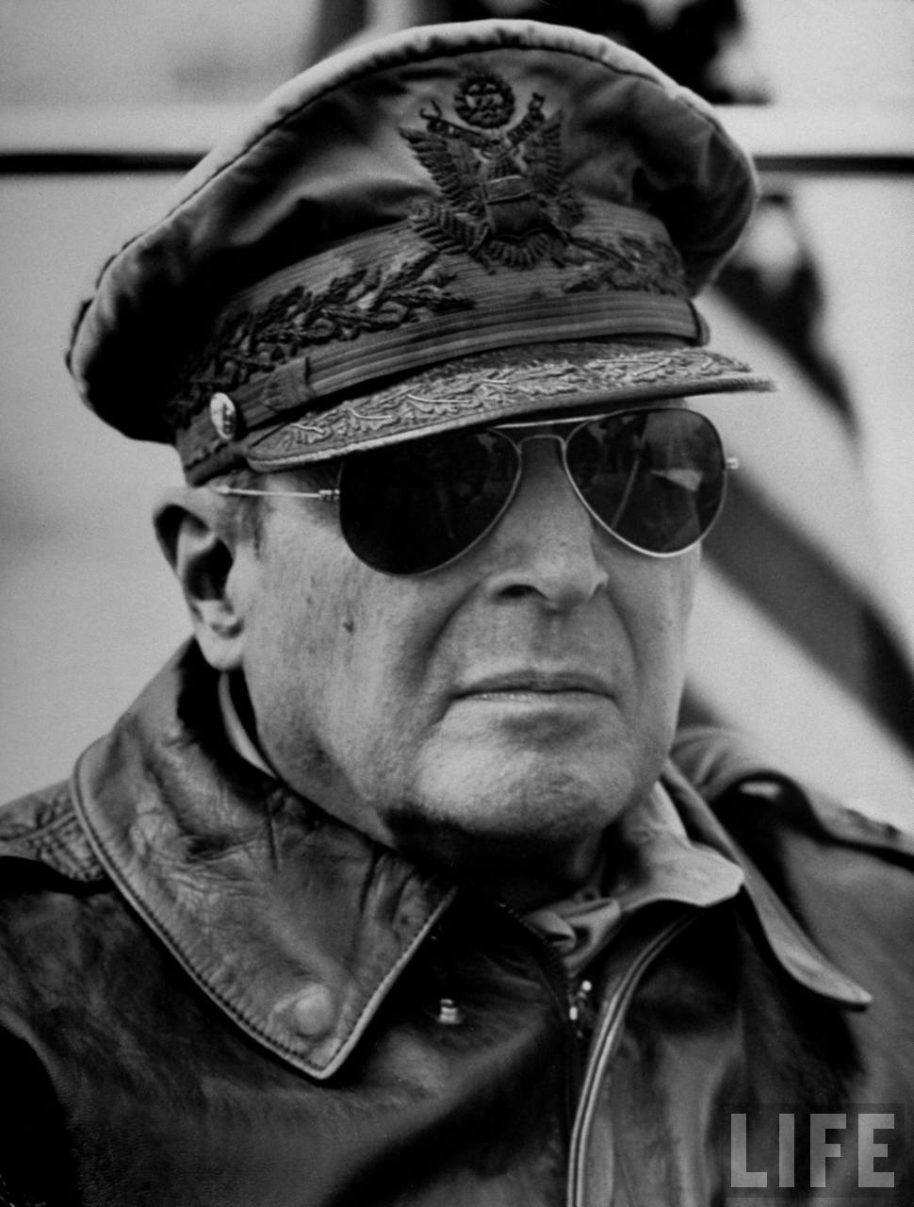
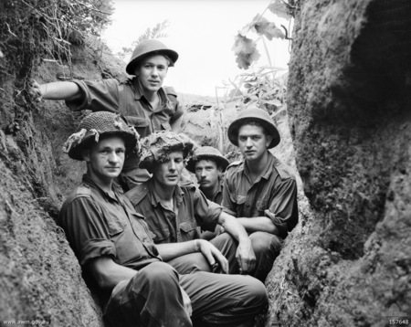

Slide 34
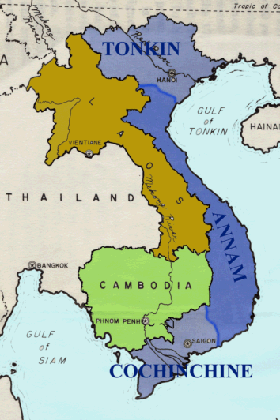
Vietnam War
Vietnam, Laos, and Cambodia was known as French Indochina prior to WWII. It was a colony of FR.
During WWII the area was volatile and remained under control of JP
FR tries to gain back its colony after WWII with the help of US
Ho Chi Minh led a nationalist movement to allow his country to remain independent. He turned to the SU for help.
FR was defeated in 1954
Fear of Communism spreading! If Vietnam falls, other Asian countries will follow = Domino Theory

Slide 35
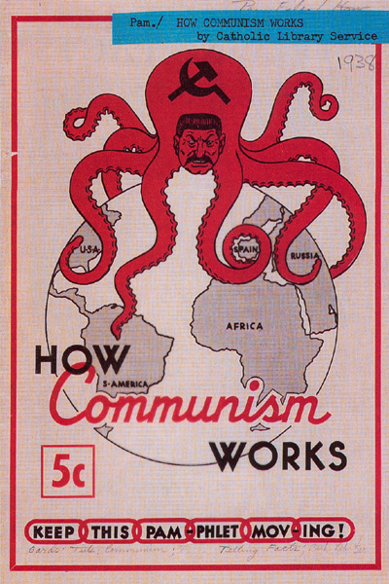
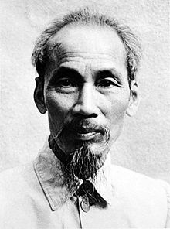

Slide 36
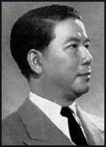
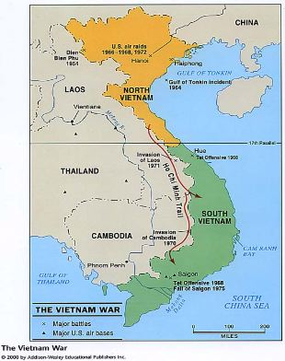
Vietnam War Cont.
Vietnam is divided at the 17th parallel
North: Ho Chi Minh, communism, support of the SU
South: Ngo Dinh Diem, anti-communist, support the US and FR
Communist guerillas (Viet Cong) were crucial in the war. The US military was sent to help fight North Vietnam and Ho Chi Minh. Men were unfamiliar with the geography (jungle terrain). Was was also unpopular in the US with American citizens.
Following the Tet Offensive in 1968, 500,000 more troops were sent the Vietnam
SU fuels the Viet Cong and Minh with supplies and money
Under the Nixon presidency the US leaves Vietnam in 1973. Two years later the North Vietnamese overran South Vietnam and unified the country. 1.5 million civilians dead and 58,000 American soldiers

Slide 37
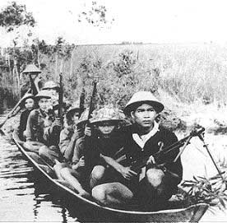

Slide 38
Cuban Missile Crisis
Kennedy v. Khrushchev (and Castro)
Bay of Pigs invasion was an attempt to take over the recently turned communist state of Cuba (Castro) – ultimate failure for Kennedy and embarrassment
Tension rises when SU places missiles on Cuba (90 miles from FL) …

Slide 39
SALT
Strategic Arms Limitation Talks (Treaty),
November 1969 to May 1972
US and SU negotiated the first agreements to place limits and restraints on some of their central and most important weapons.
The two nations took the first steps to check the rivalry in their most powerful land- and submarine-based offensive nuclear weapons.
REDUCTION IN ARMS

Slide 40
Détente
Throughout the 1960's and 1970's "détente" had been used to ease bad relations between the superpowers.
Stalin will die of natural causes in 1953. The new leaders of the USSR will be more open to the idea of “détente”.

