Slide 1
Warm-up
Which quote most likely was made by an absolute monarch?
“the government that governs best govern least”
“the government must be based on a sound constitution”
“it is the parliament that must make laws”
“I am the state”
What are some freedoms you receive in America that aren’t freedoms in every country?
Why do you believe you receive the freedoms you mentioned above?

Slide 2
Age of Enlightenment
Enlightenment- a new intellectual movement that stressed reason, thought and the power of individuals to solve problems
Philosophes—enlightened thinkers that dedicated themselves to exposing social problems and fixing them
Notes:
Attacked superstition, ignorance, and easy acceptance of authority
Used scientific method

Slide 3
Philosophes Key Ideas
Reason—informed thinking about social problems
Nature and natural laws— believed natural laws regulate both the universe and human society
Happiness- seek well-being here and now not later
Progress- the discovery of laws of economics and government would improve society and make progress
Liberty- they wanted to remove restrictions on speech, religion, and trade.
Toleration- philosophes advocated full religious toleration
Notes:
Scientific revolution demolished old ideas. People looked at world in scientific way and everything was controlled by natural laws

Slide 4
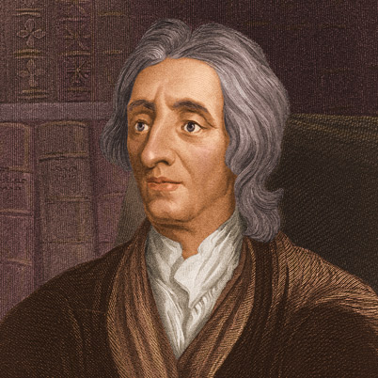
John Locke
Locke rejected the ideas that humans are innately
brutish. People are instead the products of their training,
education and experience.
Humans had a natural ability to govern their own affairs and to look after the welfare of society
Favored the idea of self-government
All people are born with 3 natural rights
Life
Liberty
Property
These rights are derived from what Locke called the “law of nature”. Government is a contract in which the rulers promise to safeguard the people’s natural rights. If rulers betray their trust, the governed have the right to replace them.
Video

Slide 5
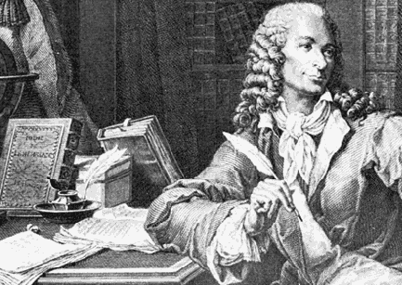
Voltaire (Pen name)
Probably the most brilliant and influential of the philosophes
He criticized France’s rigid government and denounced religious intolerance.
Although he made lots of enemies he never stopped fighting for tolerance, reason, freedom of religious belief and freedom of speech (hm…sound familiar?)
“ I Do not agree with a word you say but will defend to the death your right to say it”

Slide 6
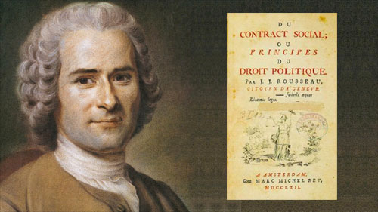
Rousseau
Passionately committed to individual freedom
He believed the sovereign power in a state does not lie in a ruler. Instead it resides in the general will of the community as whole. – DIRECT DEMOCRACY
Rulers are seen as servants to the community. If they fail to carry out the people’s will, they should be removed.
The Social Contract is a book written by Rousseau, is one of the most influential books on political theory in European history. It stated that people CHOSE to give up some of their freedom in order for the common good of society.

Slide 7
Legacy of the Enlightenment
It examined such principles as
Divine right of monarchs
The union of church and state
The existence of unequal social classes
Produced three long-term effects that helped shape western ideas
Belief in progress
A more secular outlook
Importance of the individual

Slide 8
Belief in Progress
Galileo and Newton opened the doors in science to new discoveries
Scientists made key new discoveries in chemistry, physics, biology and mechanics
Success in the Scientific Revolution gave people confidence that human reason can solve social problems
Philosophes and reformers urged an end to the practice of slavery and argued for greater social equality, as well as a more democratic style of government.

Slide 9
More secular outlook
Remember secular means “worldly” or “non-religious”
People began to question openly their religious beliefs and the teachings of the church
Newton is going to discover that some “mysteries of God” could be explained mathematically and Voltaire is going to attack the practice of organized Christianity
They wanted to promote tolerance of all religions

Slide 10
Importance of the individual
As people began to turn away from the church and royalty for guidance, they looked to themselves instead.
Government, they argued, was formed by individuals to promote their welfare.

Slide 12
“Man is born free, and everywhere he is in chains” - Rousseau

Slide 13
The enlightenment Spreads
Ideas spread with the help of books, magazines, and word of mouth
Influenced everything from the artistic world to governments
Paris is going to be the cultural and intellectual capital of the Europe

Slide 14
Angered both the French Government and Catholic Church
They said it undermined church authority, encouraged a spirit of revolt, and fostered “moral corruption, irreligion and an unbelief”.

