Slide 1
Industrial Revolution
AP World History
Beemon

Slide 2
Standard 5.1
Industrialization fundamentally altered the production of goods around the world. It not only changed how goods were produced and consumed, as well as what was considered a “good,” but it also had far-reaching effects on the global economy, social relations, and culture. Although it is common to speak of an “Industrial Revolution,” the process of industrialization was a gradual one that unfolded over the course of the eighteenth and nineteenth centuries, eventually becoming global.

Slide 3
What was the Industrial Revolution?
Lasted over the course of the 18th and the 19th centuries
Started in Great Britain
Spurred by an Agricultural Revolution
First advancements made in textile industry
Manual labor and use of domesticated animals replaced by machine
Impacted ALL aspects: SPICE
Water → Steam → Electricity

Slide 4
Aspects of the Industrial Revolution
Order:
Agricultural Phase
Water Power and Development of Factories
Steam Power
Advancements in Communication
Advancements in Transportation
Social Implications: rise of a middle class, power of capitalists, women in factories, child labor
Political Implications: suffrage, regulation vs. laissez faire, Imperialistic policies
Environmental Implications: pollution, urbanization, demographic shifts, coal/rivers
Cultural Implications: materialism, working class leisure, philosophies
Economic Implications: Marxism, Capitalism, Socialism, Communism, Neo-Imperialism, corporations, monopolies

Slide 5
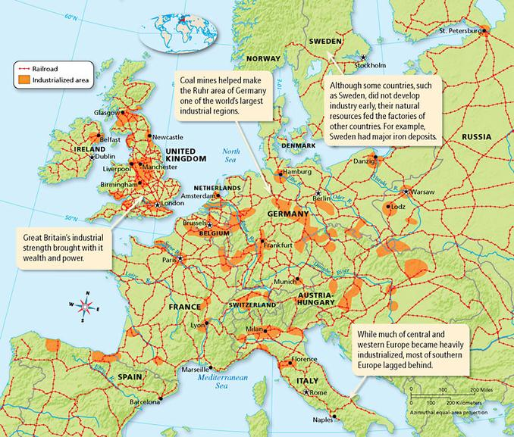
Geography of the Industrial Revolution

Slide 6
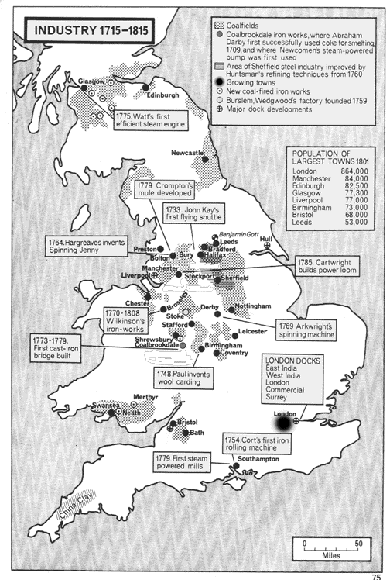

Slide 7
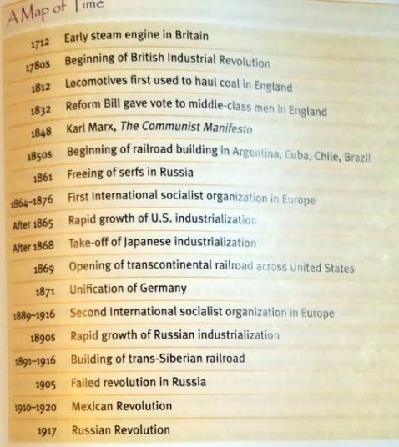
Timeline of the Industrial Revolution

Slide 8
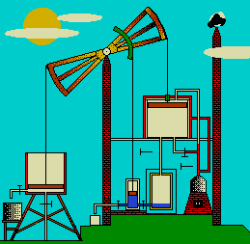
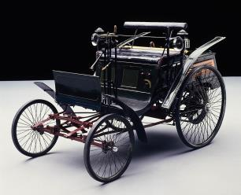
Two Phases of the Industrial Revolution
Agricultural, Textile, and Steam
Electricity, Communication, and Transportation

Slide 9
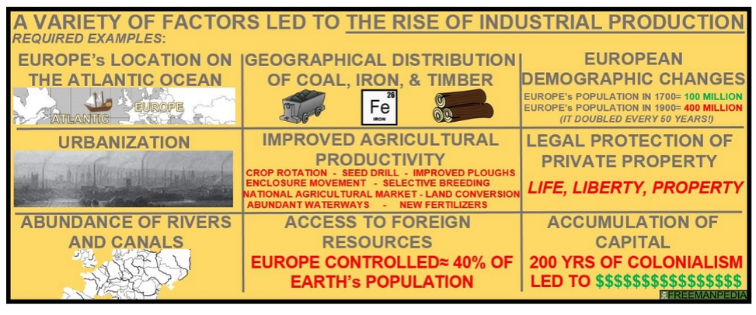
Necessary Pre-Conditions

Slide 10
Agricultural Revolution
Population
Crop rotation
Seed drill
Cotton gin

Slide 11
A New Way of Production
Factory
System
(originally the domestic system)

Slide 12
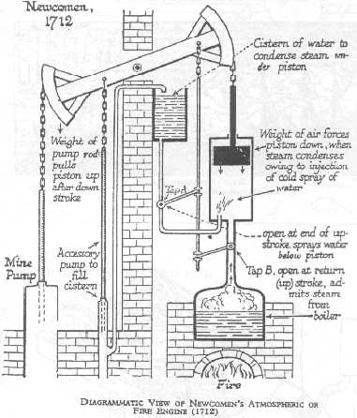
New Power
Steam – James Watt
Steam locomotive, steam ship

Slide 13
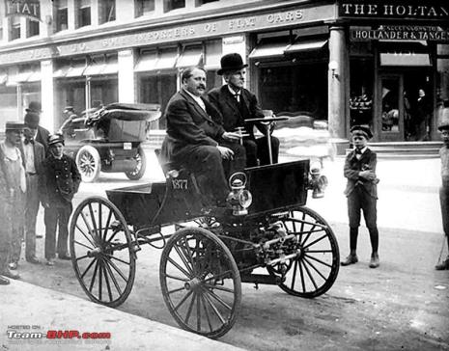
Power of Electricity & Transportation
Volta - 1774
Morse - 1825
Edison - 1879
Duryea Brothers - 1895

Slide 14
Summary
What changes are you seeing from the Industrial Revolution in the following areas?
SOCIAL
POLITICAL
HEI
INNOVATIONS
CULTURE
ECONOMIC

Slide 15
Social Implications of the Industrial Revolution

Slide 16
Urbanization and Demography Shifts
Urbanization: Industrial centers grew rapidly through in the 19th c. Large cities struggled to provide such services as water delivery, sewage disposal, police and fire protection, public education.
Urbanization and Migration
Industrialization drew migrants from countryside to urban centers
a. By 1900, 50% of pop. of industrialized countries lived in towns
b. By 1900, >150 cities w/ > 100,000 in Europe & N America
c. Urban problems: shoddy houses, fouled air, inadequate water supply
d. By late 19 C, gov’ts passed building codes, built sewer systems
Transcontinental migration: workers sought opportunities abroad
a. 1800-1920, 50 million Europeans migrated to N & S America
b. Fled: famine in Ireland, anti-Semitism in Russia
Dawn of the Industrial Revolution (mid 1700s), the world’s population grew by about 57% to 700 million. It would reach one billion in 1800, 1.6 billion by 1900, and 2 billion by 1927.
The birth of the Industrial Revolution altered medicine and living standards.
Human population growth is tied with increased use of natural and man-made resources, energy, land for growing food and for living, and waste by-products that are disposed of, to decompose, pollute or be recycled. This exponential population growth led to the exponential requirements for resources, energy, food, housing and land, as well as the exponential increase in waste by-products.
Urbanization

Slide 17
How the Other Half Lives
https://www.youtube.com/watch?v=BE35QKyh2tU

Slide 18
New Social Structure & Ideologies
Dramatic changes to the industrial family
Sharp distinction btwn work & family life, worked long hours outside home
Family members led increasingly separate lives
Working Class
Working-class culture: bars, sports, gambling, outlets away from work
Many children forced to work in industry to contribute to family support
1840s, British Parliament began to regulate child labor
1881, primary education became mandatory in England
New Aristocracy (Robber Barons or COI?)
Middle Class: managers, bankers, factory owners
Working Class: unskilled, poorly paid (proletariat)

Slide 19
New Social Structure & Ideologies
1) Karl Marx (1818-1883) and Friedrich Engels (1820-1895), leading 19th century socialists
a. Scorned the utopian socialists as unrealistic, unproductive
b. Critique of industrial capitalism
Unrestrained competition (capitalism & laissez-faire) will lead to ruthless exploitation of working class
2) The Communist Manifesto, 1848
a. Claimed excesses of capitalism would → communist revolution
b. “Dictatorship of the proletariat” would destroy capitalism
c. Socialism would follow; a fair, just, & egalitarian society
3) Social reform came gradually, through legislative measures
a. Regulated hours & restricted work for women & children
b. Bismarck’s Germany provided medical insurance & social security, not from any moral sense of humanitarianism, but as a manipulative/cynical method of calming the working class
4) Trade unions formed to represent interests of industrial workers
a. Faced stiff opposition from employers & gov’ts
b. Forced employers to be more responsive to workers’ needs; averted violence
c. No successful strikes until after 1900

Slide 20
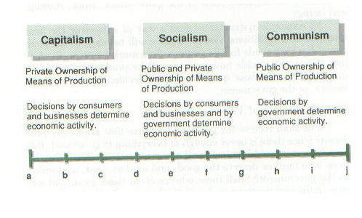
Economic Ideologies
Where does the U.S. fall today?
Adam Smith
Wealth of Nations
Karl Marx
The Communist Manifesto

Slide 21
BIG IDEA Questions
What combination of factors were necessary to begin the Industrial Revolution?
What “new” markets did industrialized states look/create for their exports?
What were the important developments in transportation during the Industrial Revolution?
How did factories change the nature of labor itself?
How did the Industrial Revolution affect the scale of businesses and overall economic activity?
What financial institutions facilitated industrial production?
How did the Industrial Revolution affect social & demographic characteristics?
How did workers respond to the Industrial Revolution, and how did their vision of society compare to industrialists’?
How did governments respond to the tremendous economic changes of the Industrial Revolution?

Slide 22
Writing Activity (project grade)
Using the resources provided, create a written piece of creative writing that incorporates aspects of Industrial Revolution living standards in England.
Options:
Diary
Letter
Newspaper article (muckraker)
You choose:
Male, Female, Age
Working Role
Must include:
Working conditions, living conditions, aspects of city life (urbanization)
Facts, evidence from the resources provided
Make it special!
Typed, aged, Front page of a newspaper
Due Monday at the beginning of class

