Slide 1
Day One
Nationalism & Industrial Revolution

Slide 2
First 10
Work on Nationalism Worksheet

Slide 3
Define: nationalism
  a feeling that people have of being loyal to and proud of their country often with the belief that it is better and more important than other countries
  a desire by a large group of people (such as people who share the same culture, history, language, etc.) to form a separate and independent nation of their own
    How do we (Americans) show nationalism today? How have we shown it in the past?

Slide 4
How Nationalism can unify a nation: | How Nationalism can dismantle a nation:
Brings people together Nation-state- common culture, lang, history Ex: Germany | Break apart No loyalty to the King/emperor Ethnic groups and/ nation Ex:Austria-Hungary

Slide 5
MAIN Causes of WWI
Militarism
Alliances
Imperialism/ Industrialization
Nationalism

Slide 6
Nationalism
Political
Parties
Conservatives
Support Kings
(Nobility and
Wealthy)
Liberals
Power to elect
legislatures
Merchants/Middle
Class
Radicals
END KING
EVERYONE
votes
To the COUNTRY not the KING

Slide 7
Work Session
Comparing Nationalism in the 19th century – Case Study: Japan and Germany
30 minutes
Vs.

Slide 8
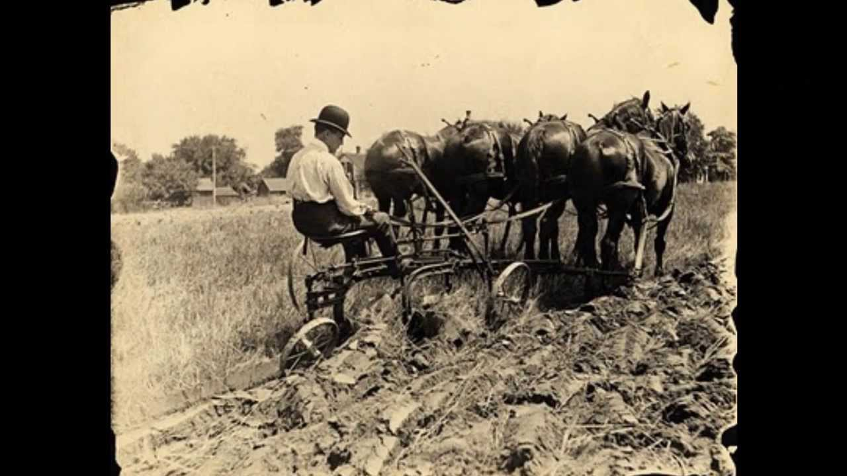
Agricultural Revolution
Definition: when new inventions made farming easier and faster
Cause: Enclosure movement- fencing in farmland
Small landowners sell to wealthy landowners
Inventions: seed drill, crop rotation, cotton gin
Effects: increase food supply, population growth, people move to cities; increase demand for textiles

Slide 9
World Population Growth
7.5 billion
6.7 billion
2018
6 billion
1997
5 billion
2 billion
1994
1 billion
1987
1950
1860

Slide 10
Agricultural Revolution
Changes to family structure:
Domestic system- family members take part in the production of home goods
Factory system- production of goods by machines
  family members live independent lives

Slide 11
The Industrial Revolution

Slide 12
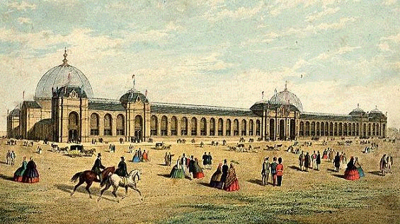
Why England?
FACTORS OF PRODUCTION
  Land, Labor, Capital
Natural Resources (LAND)
  Water—
    rivers for inland transportation
    Harbors for merchant ships
  Minerals—coal & iron
  Raw materials
Government (LABOR)
  Political stability
  Growing population
Expanding economy (CAPITAL)
  Strong currency and banking
  Educated middle class
  Overseas trade

Slide 13
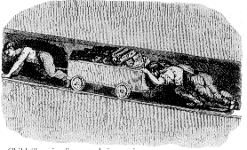
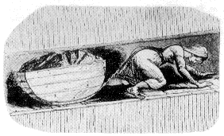
Child Labor in the Mines
Child
“hurriers”

Slide 14
Impact of Industrialization
Urbanization
Living conditions
  Inadequate housing, education, police protection
  Dirty, unsanitary, illnesses spread
Working conditions
  Long days
  Dangerous machines
  Women and children
Class tensions grew between middle and lower class

Slide 15
Effects of the Industrial Revolution
Negative
Poor working conditions
Poor living conditions
Poor health due to lack of income
Spread of disease/lowlife expectancy
Child Labor
Desire for more natural resources → Imperialism
Positive
Middle Class increases due to the creation of jobs
It contributed to the wealth of a nation.
It fostered the technological growth.
It increased production of goods & lowered prices.
Industry will spread to the U.S.

