Slide 1
2020 AP History DBQ
DBQ Basics

Slide 2
Basics
You will have 45 minutes to complete the DBQ. This includes reading the documents and writing the essay.
You will have 5 additional minutes for upload.
You can hand write and upload your response OR you can type your response.

Slide 3
Introduction Paragraph *0-2 pts*
The Introduction Paragraph has not changed.
Students are still expected to provide contextualization and a thesis statement.
Contextualization (1 point)
Sets the stage for the historic event you will discuss in the essay
Example:
Discussing political revolutions of the 18th and 19th centuries prior to discussing Neo-imperialism
Discussing rise of the Ottoman Empire prior to discussing the European Age of Exploration
Discussing the Agricultural Revolution prior to discussing Industrialization
Thesis (1 point)
Directly responds to the prompt and provides an outline for the topics of your essay
Example: To what extent did Christianity impact Latin American societies from 1600-1800?
Christianity greatly impacted Latin Americans societies by ___________, ______________, and _______________.
Example: Compare the impact of the spread of Islam on South Asia and West Africa.
Islam impacted both South Asia and West Africa by ________________________________. However in West Africa, ______________________, while in South Asia _________________________.
Example: Analyze the extent to which absolute monarchs in Western Europe exercised absolute control over populations from 1300-1700.
Absolute monarchs maintained absolute power over populations by ________________________, However, their power shifted after _____________________.

Slide 4
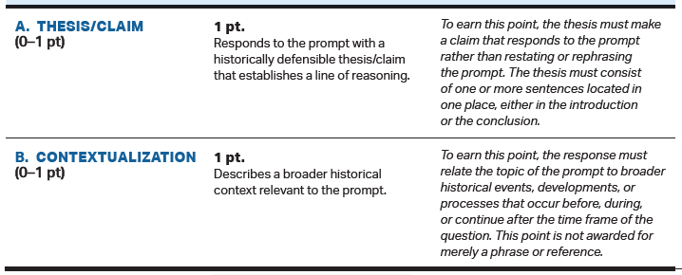

Slide 5
Evidence From the Documents *0-3 pts*
These points will be earned in the body of your essay
Uses the content of at least two documents to address the topic of the prompt (1 point )
Accurately describes the content in the documents (rather than quoting)
Supports and argument in response to the prompt using two documents (1 point)
When you are describing the content of the document, you are relating it back to the prompt to support your thesis
Supports and argument in response to the prompt using at least four documents (1 point)
Same as above, but you use 4 documents

Slide 6
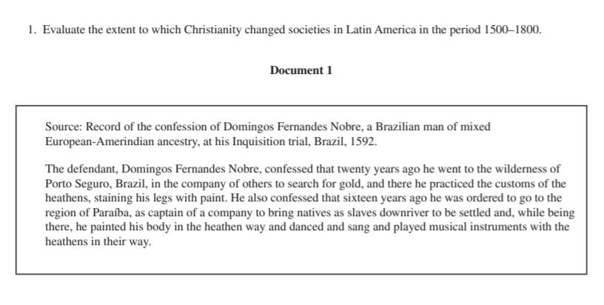
Using vs. Supporting
Using the content
Nobre’s confession shows that areas in Brazil were still practicing indigenous religions rather than adhering to Catholicism. (Doc 1)
Supports an argument
Despite the spread of Catholicism in the New World, many individuals still maintained traditional religious practices when further away from settled areas. Nobre’s confession shows that areas in Brazil were still practicing indigenous religions rather than adhering to Catholicism. This confession is significant because it presents a situation where someone of mixed ancestry is trying to maintain both cultures. (Doc 1)

Slide 7
Outside Evidence *0-2 pts.*
Must be within the body of your essay
Uses at least one additional piece of the specific historical evidence (beyond that found in the documents) relevant to an argument about the prompt (1 point)
Describes a second piece of specific historical evidence. (1 point)
Think:
Vocabulary
People
Place
Historic Event

Slide 8
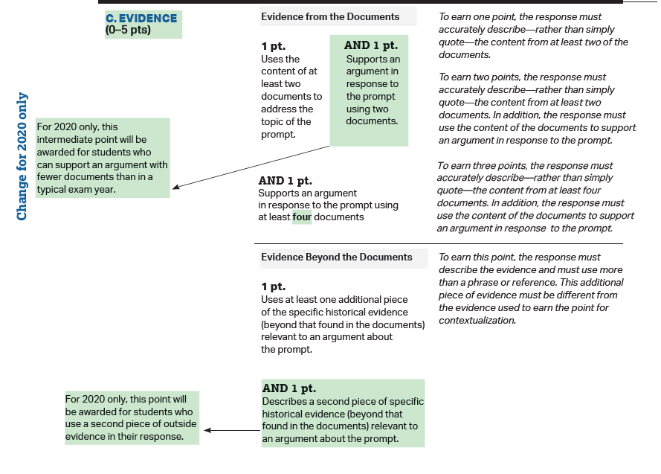

Slide 9
Analysis and Reasoning *0-2 pts*
For one document, explains how or why the document’s POV, purpose, historical situation, or audience is relevant to an argument (1 point)
HIPP Acronym:
Historical Situation – What is happening at the time period and place that influences the document or author
Intended Audience – Who is supposed to view this docuent, photograph, graph, etc. How does that shape the document?
POV – How does the invidual’s background, culture, ethnicity, socio-economic status, gender, occupation, etc. influence their writing, photography, art, etc.
Purpose – Why is this document being written? How does the reason it is being created influence the document?
For two documents explains how or why the document’s POV, purpose, historical situation, or audience is relevant to an argument (1 point)
Be sure to explain HIPP rather than identifying

Slide 10
Identifying vs. Explaining
Identifying
Nobre is presenting this as a confession in front of the Inquisition.
Explaining
The fact that Nobre is confessing in front of the Inquisition shows the power of the Catholic Church in the late 16th century. They were clearly trying to control religious practices in the colonies, even threatening punishment for practicing indigenous religions. (Historical Context)
Identifying
Nobre is of mixed European-Amerindian ancestry.
Explaining
Because Nobre is of mixed European-Amerindian ancestry, it is likely that he is attempting to maintain connections to his indigenous roots by practicing religion when he is far away from European settlements. (POV)
Identifying
Nobre calls the people practicing indigenous religions, “heathen.”
Explaining
Nobre references indigenous practices, “heathen.” Likely trying to show his innocence since he is confessing in front of the Inquisition. Although he participated, he is trying to show that this was something from the past and he is different from the “heathen” way. (Intended Audience)

Slide 11
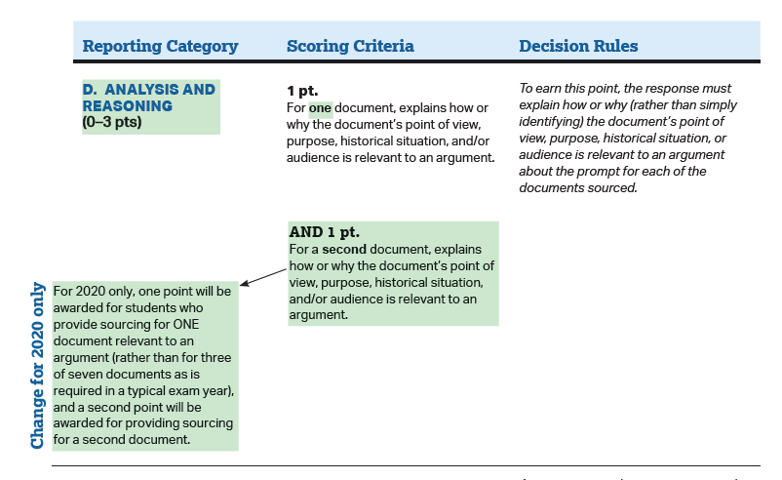

Slide 12
Synthesis *0-1 pt.*
This is usually present at the end of your essay.
Because this is one point, I recommend focusing on this only if you finish the rest of your essay. Do not stress if you do not get to this point of the essay. You can still score relatively high without the synthesis point.
Demonstrates a complex understanding of the historical development that is the focus of the prompt, using evidence to corroborate, qualify, or modify an argument that addresses the question. (1 point)
Possibilities:
Explaining nuance of an issue by analyzing multiple variables
Explaining relevant and insightful connections within and across periods
Confirming the validity of an argument by corroborating multiple perspectives across themes.
This understanding must be part of the argument, not merely a phrase or reference.

Slide 13
Examples of Synthesis
Explaining nuance of an issue by analyzing multiple variables
Counter-argument to your overall focus.
Example:
The essay is about the Enlightenment providing equality and liberties to people but for your synthesis you discuss the fact that it did not extend liberties to enslaved people, landless people, and women.
Explaining relevant and insightful connections within and across periods
Connecting the historical event to other events in the world (same or different time periods)
Example:
The essay was about political revolutions of the 18th-19th centuries and you draw a clear comparison (3-4 points of comparison) to the revolutions of the Arab Spring or even the nationalist movements during decolonization.
Confirming the validity of an argument by corroborating multiple perspectives across themes.
You analyze from a different InSPECT Theme: Interaction with the Environment, Social, Political, Economic, Culture, Technology
Example:
The essay was about the economic legacy of the Crusades on Western Europe. For your synthesis, you could discuss how a byproduct of ecnomic improvement was a shift in social structure and the creation of new classes.
This understanding must be part of the argument, not merely a phrase or reference.
Typically 4-6 sentences (a paragraph)
It needs to be insightful and address the entire theme of the essay, rather than just a paragraph

Slide 14
