Slide 1
First Ten
What was the Protestant Reformation?
How did Luther impact the Reformation?
What was an indulgence?
How did the printing press invented by Gutenberg impact technology and the spread of ideas?

Slide 2
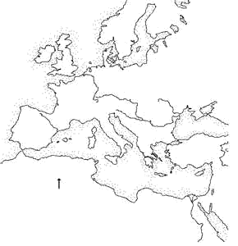
What about England?

Slide 3
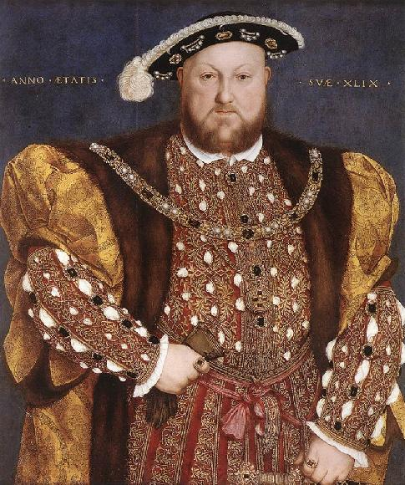
The English Reformation
England’s break with the Catholic Church was the work of the King of England, Henry VIII
(1509-1547).
Desired a son to succeed him. He and his wife (Catherine of Aragon) had not had a son, so he decided to divorce her and remarry. Divorce was forbidden in the Catholic Church, but exceptions could be granted by the pope.
The pope refused to give Henry his divorce, so Henry took England out of the Catholic church in the 1530’s and approved his own divorce.
He eventually married 6 times and finally got his male heir.
When England left the Catholic Church England became protestant and created the Anglican Church. (Church of England)

Slide 4
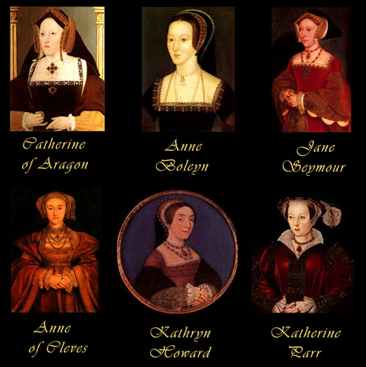

Slide 5
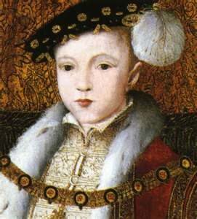
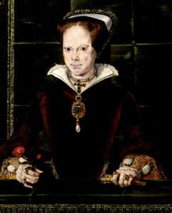
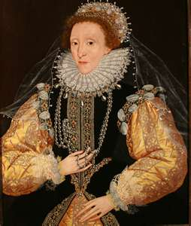
Henry’s Successors
Henry’s son Edward VI ruled at the age of 9 (with adult advisors). England remained Protestant during his rule.
When he died; Mary the daughter of Henry’s 1st wife came to rule.
  She was a devout Catholic and made England Catholic again. When the Protestants resisted she ordered their death.
In 1558 Mary died and Elizabeth I took the throne.
  She returned the Anglican Church as the only legal church of England.
http://youtu.be/3EGzHsye71c

Slide 6
COUNTER REFORMATION AKA
CATHOLIC REFORMATION
Millions left the Catholic Church during the Protestant Reformation.
Many stayed loyal to the Catholic Church and worked to bring about some change within.

Slide 7
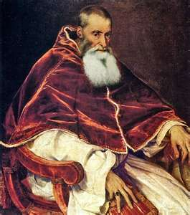
Popes of Reform
Pope Paul III – took 4 main steps to reforming the Catholic Church and reforming its image.
  1. Directed a council of Cardinals to investigate the selling of indulgences.
  2. Started the Jesuit order
  3. Used Inquisition to stomp out heresy (false teaching) in Papal states
  4. Council of Trent in Italy

Slide 8
Jesuits – The first missionaries
In 1540, the pope created a religious order of followers called the Society of Jesus. Members were called Jesuits. Had 3 main goals:
  1. developed schools throughout Europe –theology and core classes
  2. Convert non-Christians to Catholicism. Missionaries sent worldwide
  3. Stop spread of Protestantism

Slide 9
Council of Trent
Lasted from 1545-1563. Northern Italy Bishops and Cardinals agreed on doctrine concerning the Catholic Church.
  1. Churches interpretation of the Bible was final. Any substitution or change was heresy
  2. Christians needed faith & good works for salvation. Luther – faith alone
  3. The Bible and church tradition were equally powerful guiding authorities for Christians
  4. Indulgences were valid expressions of faith but false selling of them was forbidden.

Slide 10
Reformation Review – First Ten
During the Middle Ages, what was the only “church” of Western Europe?
Who is responsible for starting the Protestant Reformation?
What is an indulgence?
How did the printing press revolutionize communication?
Who is responsible for starting the English Reformation?
Explain the key changes brought about by the Counter Reformation.

