Slide 1
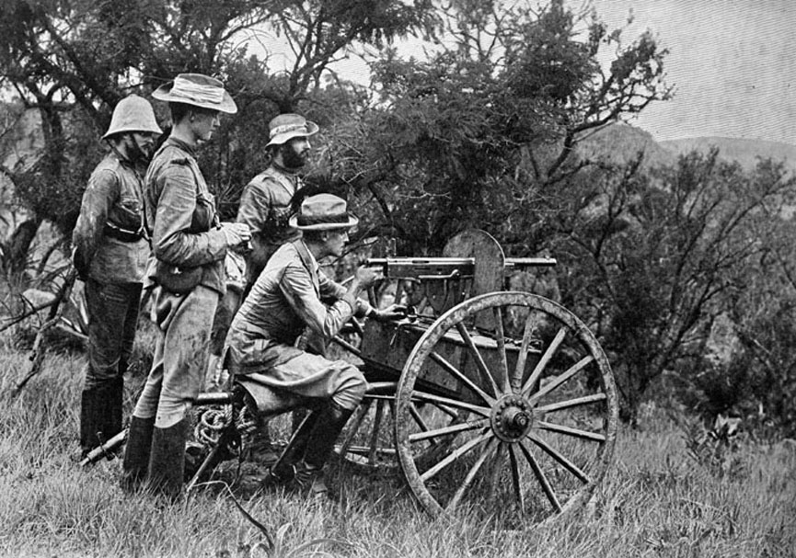
The Great War
1914-1918
SSWH16 & 17

Slide 2
Essential Question
What long-term and short-term causes led to WWI?

Slide 3
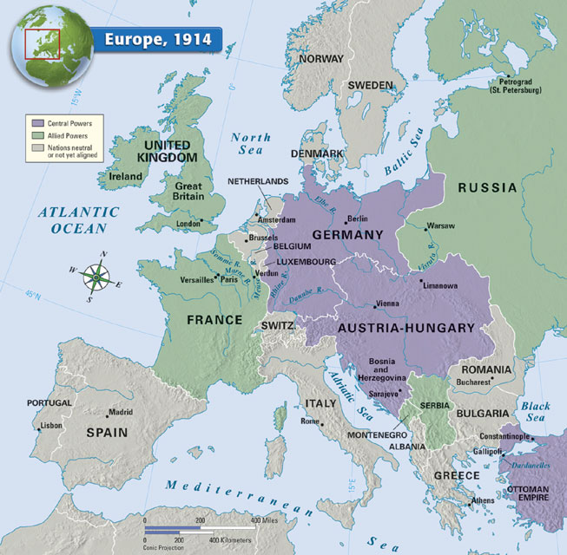

SUPERPOWERS

Slide 4
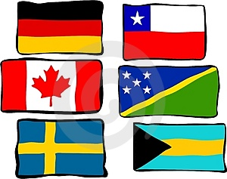

Long-Term Causes
Militarism
Alliances
Imperialism/Industrialization
Nationalism

Slide 5
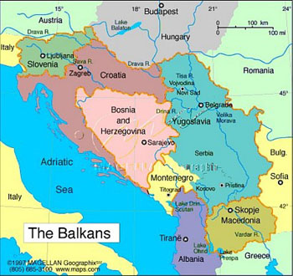
Short Term Causes
Conflict in the Balkans
Assassination of Franz Ferdinand & Wife (Archduke of Austria-Hungary)

Slide 6

Prior to WWI…
In the early 1900’s Europeans had been at peace for almost 30 years due to negotiations/treaties.
  War almost seemed as something of the past.
However there were many underlying problems that were already put into place (long-term causes…)

Slide 7
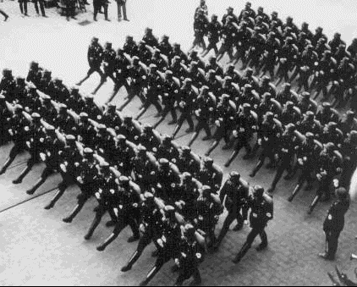
Militarism
Glorification of military skill and expertise = Militarism
Nations believed a strong military represented a strong nation (patriotism)
Mobilization was key

Slide 8
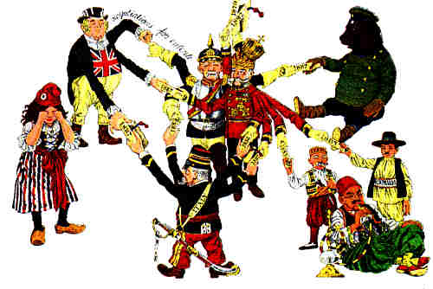
Alliance System
Bismarck (Germany)
wanted to isolate France
= Triple Alliance
  Austria-Hungary, Italy, and
  Germany (Russia is added later)
  Bismarck was worried about a war on two fronts (he was scared of France)
Kaiser Wilhelm II forces Bismarck out of power and focused on building military/navy (naval race) of Germany & lost interest in alliance with Russia.
  Russia makes military alliance with France
G. Britain forms alliance with France because Germany is trying to “out-do” the British Navy
And thus the Triple Entente is born
  Britain, France, & Russia

Slide 9
Triple Alliance
Triple Entente
Germany
Vs.
Great Britain
Austria-Hungary
Italy
France
Russia

Slide 10
Central Powers
Allied Powers
U.S.
Germany
Vs.
Great Britain
Russia
(Serbia)
France
Austria-Hungary
Ottoman Empire

Slide 11
Industrialization & Imperialism
These two aspects only added “fuel to the fire” by increasing competition and feelings of Nationalism.
  Caused a lot of mistrust between nations
Industrialization also contributed to advancements made in weaponry (use of metals) and transportation. This would change ANY war that would exist.
  Led to…..

Slide 12

Nationalism
Desire to overpower one another (Resources, Markets, etc.)
  Competition for resources
  Territorial disputes
  Balkan Conflict (Russia v. Austria-Hungary)
Great Powers of the time (see map)

Slide 13
Short-Term Causes

Slide 14
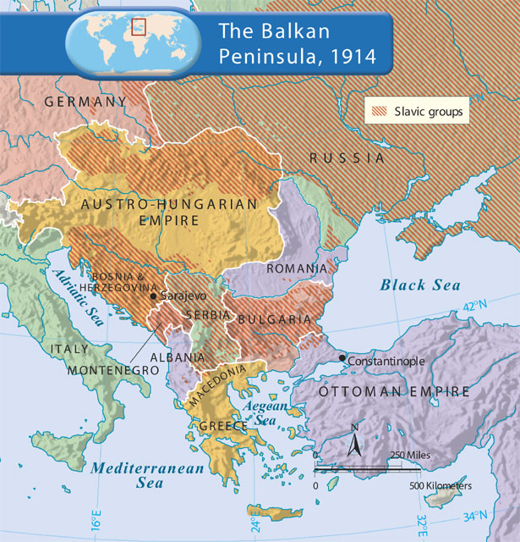
The “Powder Keg”
Balkans was considered a “powder keg” because it was a disaster waiting to happen.
Many ethnic groups were gaining their independence (because of Nationalism) from the Ottomans (Slavs, Romanians, Bulgarians, etc.)
Serbia was important (landlocked)
  High # of Slavs (Russia had Slavic population as well and supported Serbia)
  Austria-Hungary feared Serbian nationalism because their own country had a high Slavic population and feared that nationalism would spread and lead to revolution in their own country.
Austria-Hungary took over Bosnia & Herzegovina
  This angers Serbia & tension grows

Slide 15
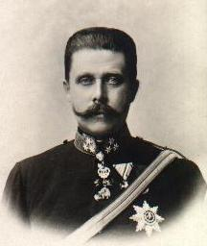
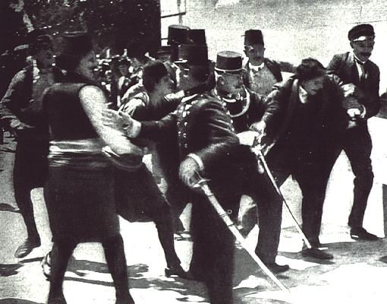
Assassination
Archduke Franz Ferdinand & Wife visit Sarajevo (capital of Bosnia)
  Shot point-blank while riding in an open car
Shot by 19 yr old Gavrilo Princip (Serbian living in Bosnia)
  Member of the “Black Hand” (Serbian Nationalist Group)
Austria declares war on Serbia
BUT Russia has their back… WAR!!!!

Slide 17
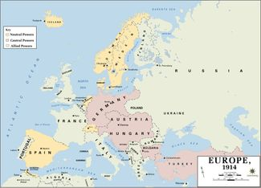
The Start of War…
Largest, most destructive war the world had ever seen.
RUS mobilized troops along the border of GM & Austria = Declaration of War (Summer 1914)
Central Powers v. Allied Powers
Western Front v. Eastern Front
http://www.history.com/topics/world-war-i/world-war-i-history/videos/bet-you-didnt-know-world-war-i

Slide 18
Exit Ticket
Connect 3 major causes of WWI and explain how it led to the assassination of Archduke Ferdinand.

Slide 20
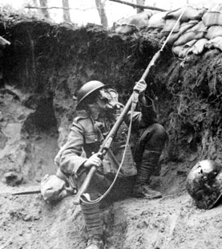
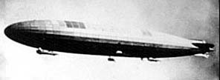
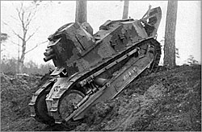
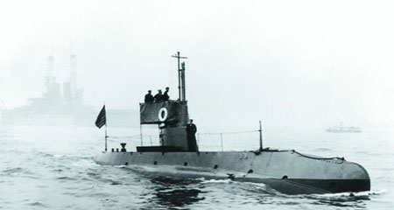
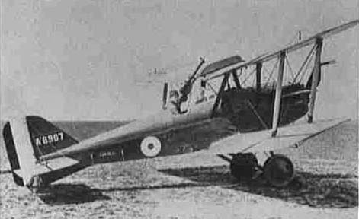
A New Kind of War…
New Technology
Modern Warfare
  Submarines
  Machine Guns
  Mustard Gas
  Zeppelin (blimp)
  Tanks
  Planes
  Torpedoes
  = 8.5 million men dead, 21 million wounded, & $338 Billion spent

Slide 21
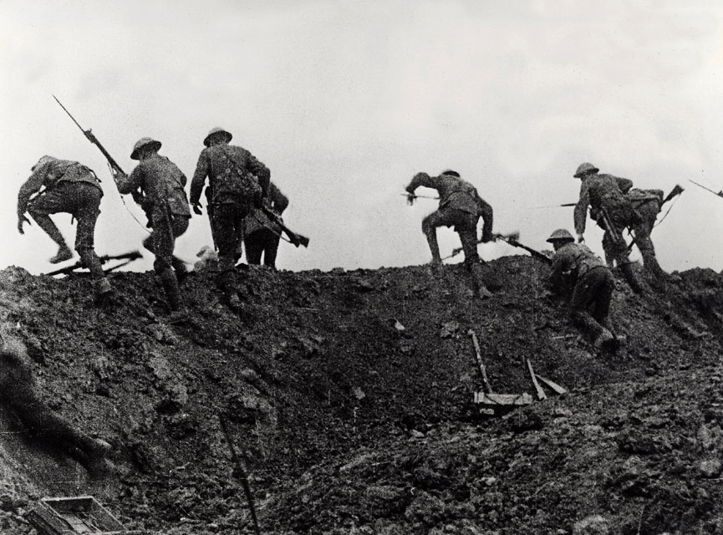
Trench Warfare
Men in the trenches had to face terrible conditions
  Did EVERYTHING in the trenches.
  “No man’s land”
  Rats and other animals
  Sleep was impossible
  Shells, body parts falling into the trenches
  Hard to breath
http://www.history.com/topics/world-war-i/world-war-i-history/videos/life-in-a-trench

Slide 22
On the Battlefield & the Battle of Verdun
The war was fought on many fronts
  Eastern Front
    GM v. RUS
    RUS suffers b/c of lack of industrialization, but it was enough to cripple the German army to help out on the W. Front. RUS leaves the war in 1917 due to revolution.
  Western Front
    Trench warfare and stalemates
  Middle East
    Gallipoli

Slide 24
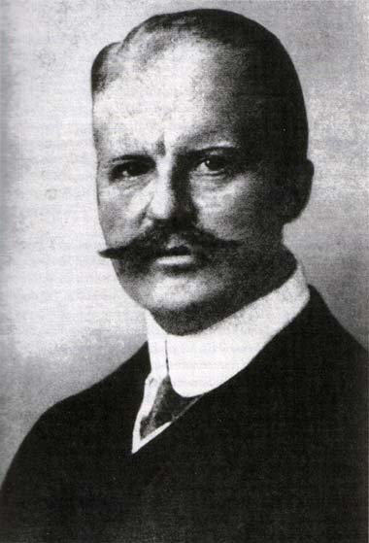
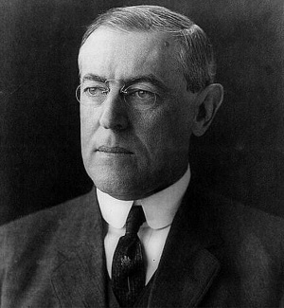
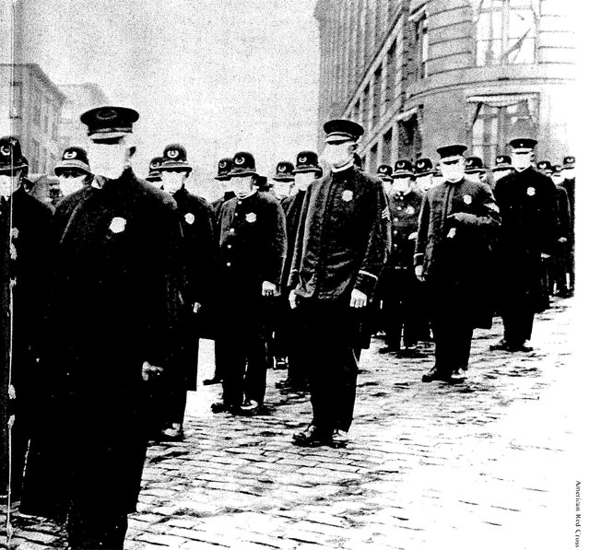
Other Aspects of War…
Lusitania - 1915
U.S. enters in April, 1917 after the Zimmerman Telegram.
After the U.S. enters they contribute over 2 million troops to FR/GB allowing for the defeat of the German @ the 2nd Battle of the Marne.
Spanish Influenza was very deadly and killed 20 million people.

Slide 25
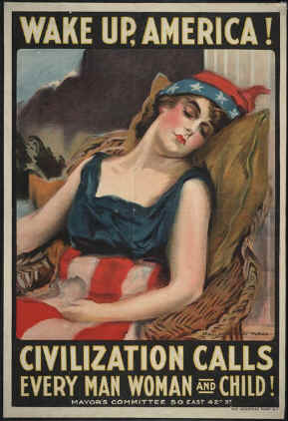
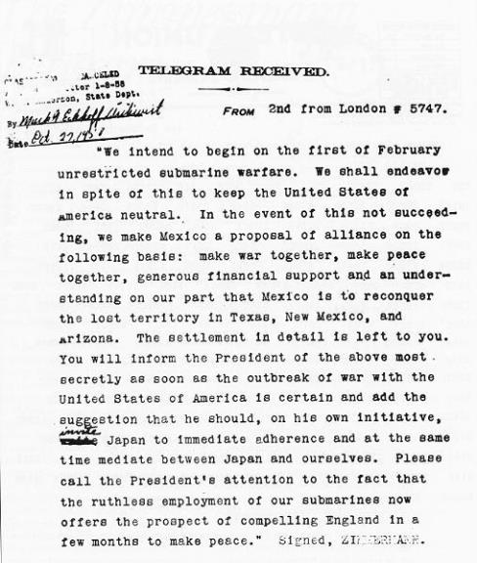
US Enters

Slide 26
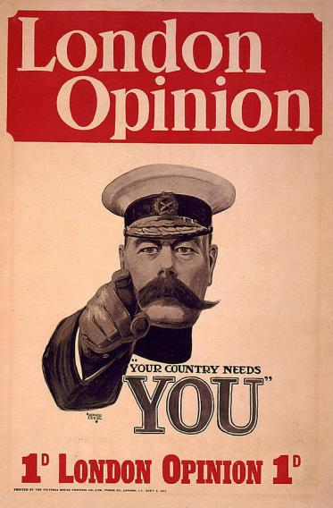
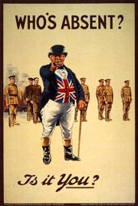
Propaganda

Slide 27
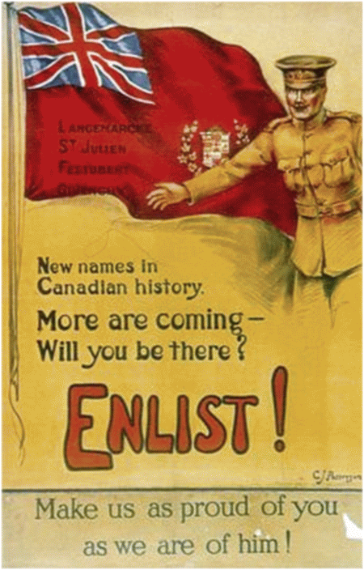
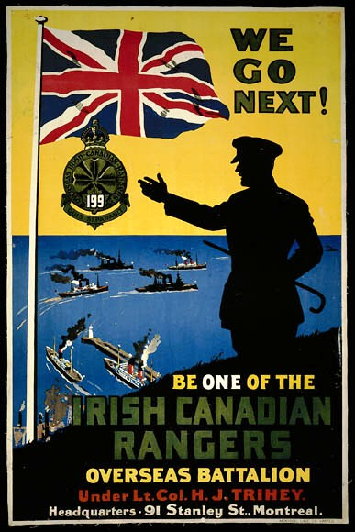

Slide 28
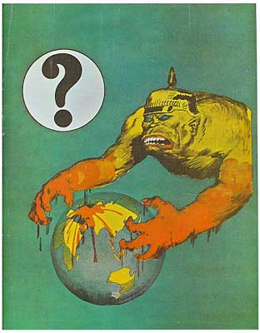
Australia Propaganda

Slide 29
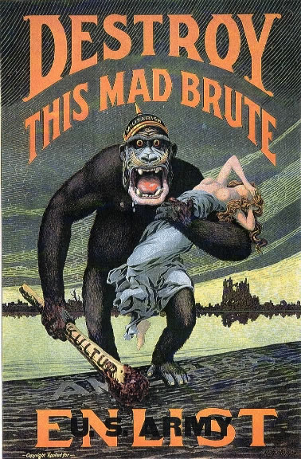
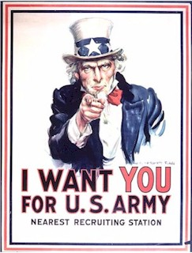

Slide 30
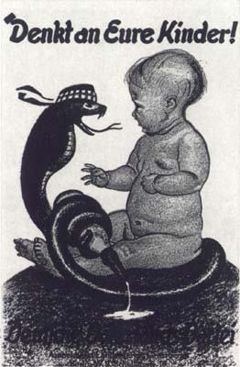
German Poster
“Think of Your Children!”
French snake has
baby’s bottle

Slide 31
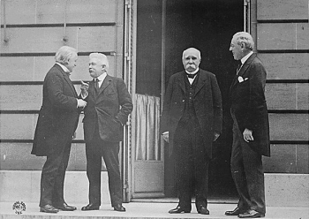
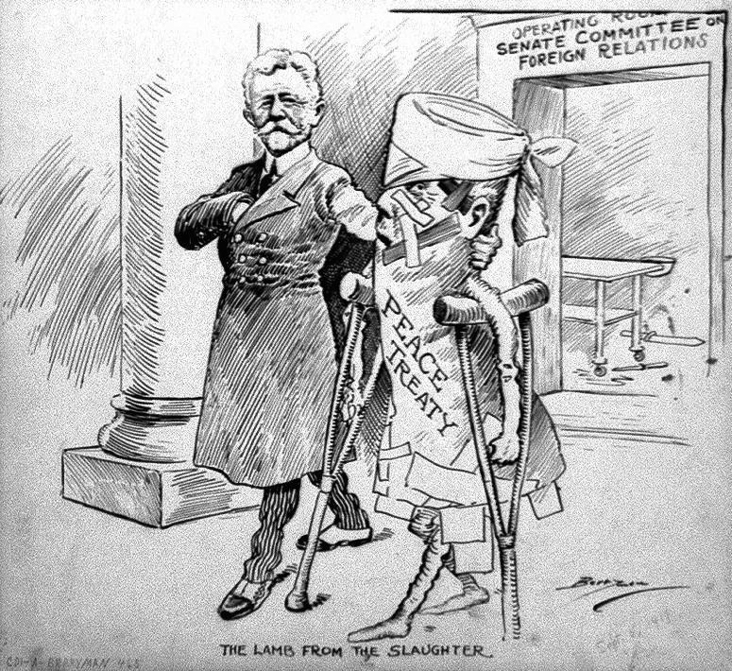
The End of War…Versailles Treaty
RUS surrenders b/c of unrest at home (Revolution)
After the 2nd Battle of Marne GM could not recover…Armistice
  November 1918
Versailles Treaty, January 1919 with the BIG 4!
  U.S., GB, FR, and IT (W. Wilson)
  14 points & the League of Nations to “keep peace”
  PUNISH GM

Slide 32
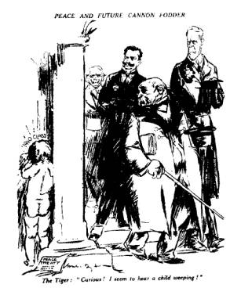
German Reparations
GM lost territory, had to disable army, and accept “war guilt.” – Article 231
  NO LASTING PEACE
  Bitterness from GM would lead to more conflict later
IT & JP would not be happy either…

Slide 33
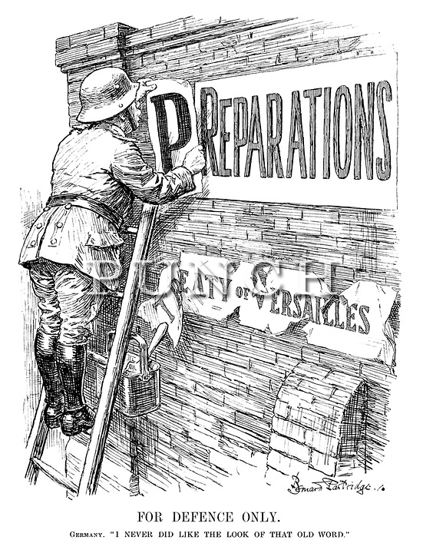
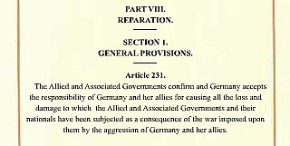

Slide 34
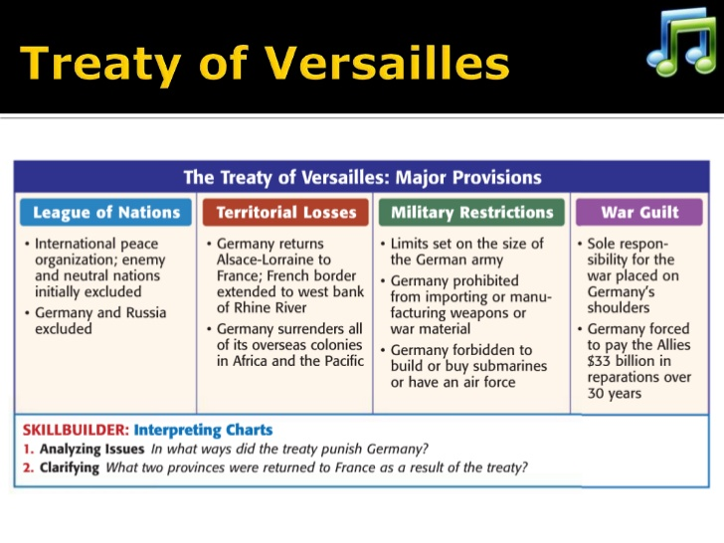

Slide 35
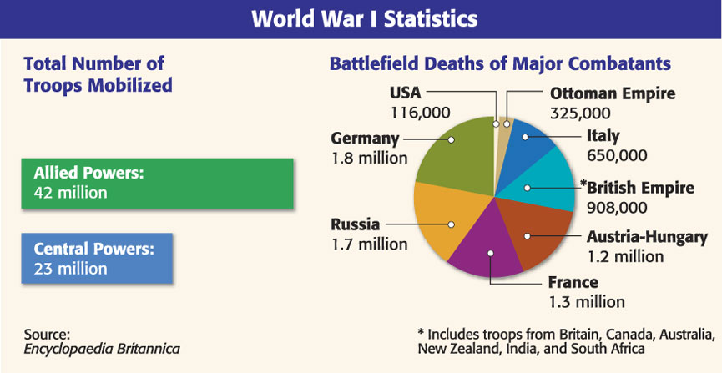
8.5 Million Dead
338 BILLION Spent
21 million wounded

Slide 36
