Slide 1
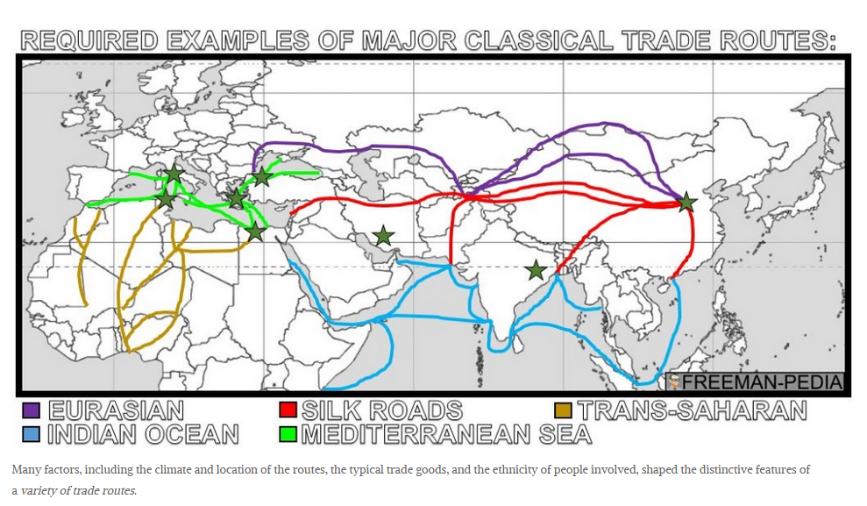

Slide 4
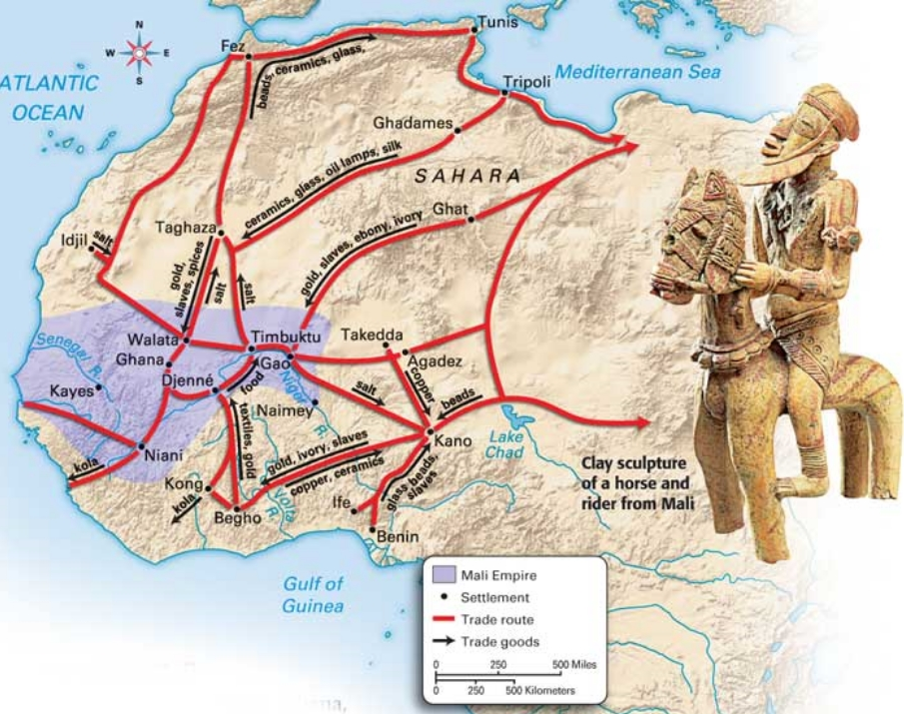
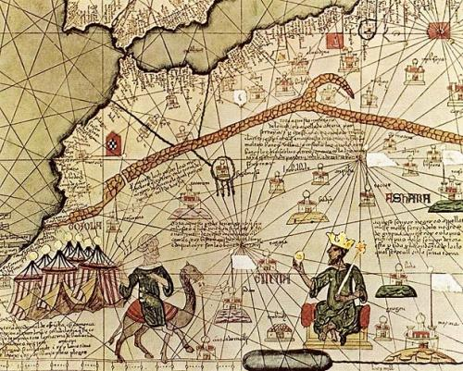
Trans-Saharan Trade
Gold and Salt were traded through the Saharan dessert with Europe and the Middle East.
Important people: Mansa-Musa, said to be the richest man who has ever lived. King of the Mali empire.
Gave away so much gold on his hajj to Mecca, to try to promote his empire and persuade people to want to trade with them.

Slide 5
Review

