Slide 1
Vocabulary review by themes
Apwh Beemon

Slide 2
Human Environment Interaction

Slide 3
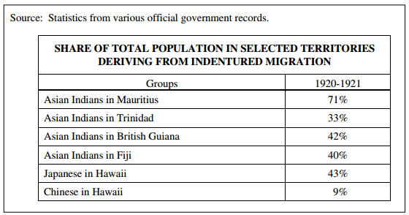
Coerced and semi-coerced labor migrations
Who: Coerced laborers were known as “coolies” from the Hindu meaning “day-laborer”
What: labor through force and intimidation(sometimes through authority), in short, coerced labor is slavery.
When: Period Five: 1750-1900: Africa, China, India
Where: By 1900, six countries had more than 10,000 people of Indian origin as laborers: British Guiana Trinidad & Tobago Mauritius Natal (South Africa) Jamaica Fiji
Why: Replaced slavery (abolished in early 1800s)
Other examples: Chinese Coolies in the U.S. (1850 – 1900) – Railroad construction in the west
In 1882, in America, there was a 10 year ban for Chinese immigration to America.

Slide 4
Flora and fauna
Flora: the plants of a particular region, habitat, or geological period.
Fauna: the animals of a particular region, habitat, or geological period.
Environmental factors such as rainfall patterns, climate, and available flora and fauna shaped the methods of exploitation used in different regions.
Different crops or animals were domesticated in the various core regions, depending on available local flora and fauna.
THINK: Columbian Exchange, agricultural opportunities

Slide 5
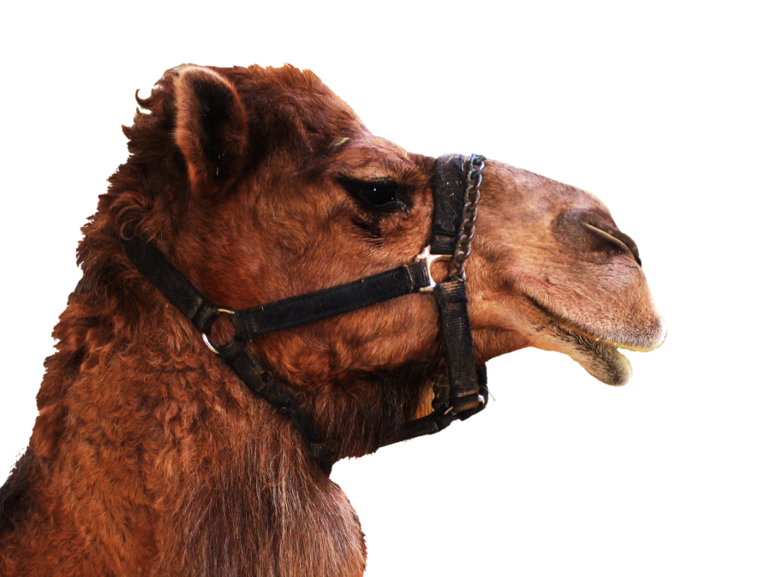
Environmental damage
Deforestation
clearing Earth's forests on a massive scale, 30% of the World is covered in forest
European colonization and the introduction of European agriculture and settlements practices in the Americas often affected the physical environment through deforestation and soil depletion.
Pollution threatened the world’s supply of water and clean air. Deforestation and desertification were continuing consequences of the human impact on the environment. Rates of extinction of other species accelerated sharply.
Desertification
fertile land becomes desert, typically as a result of drought, deforestation, or inappropriate agriculture.

Slide 6
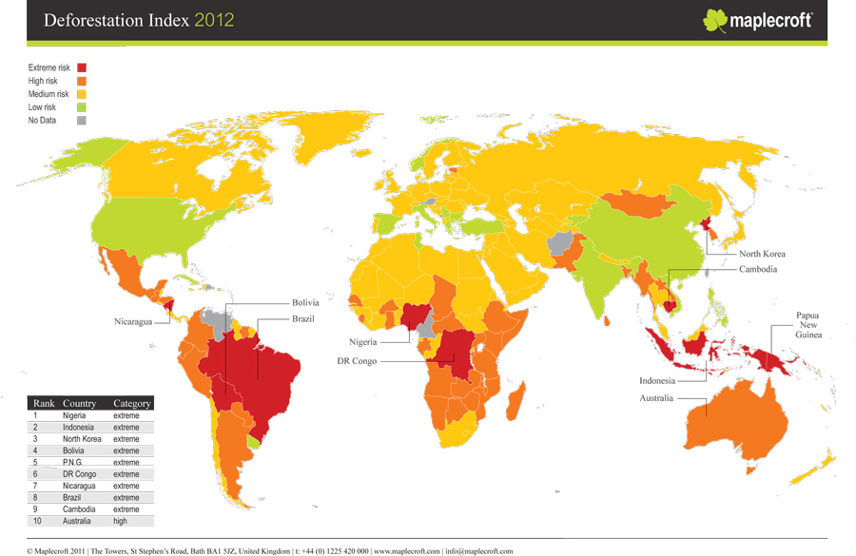

Slide 7
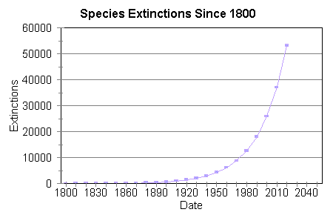
Rates of extinction
Direct effect of Deforestation (see previous slide)
Check out this link

Slide 8
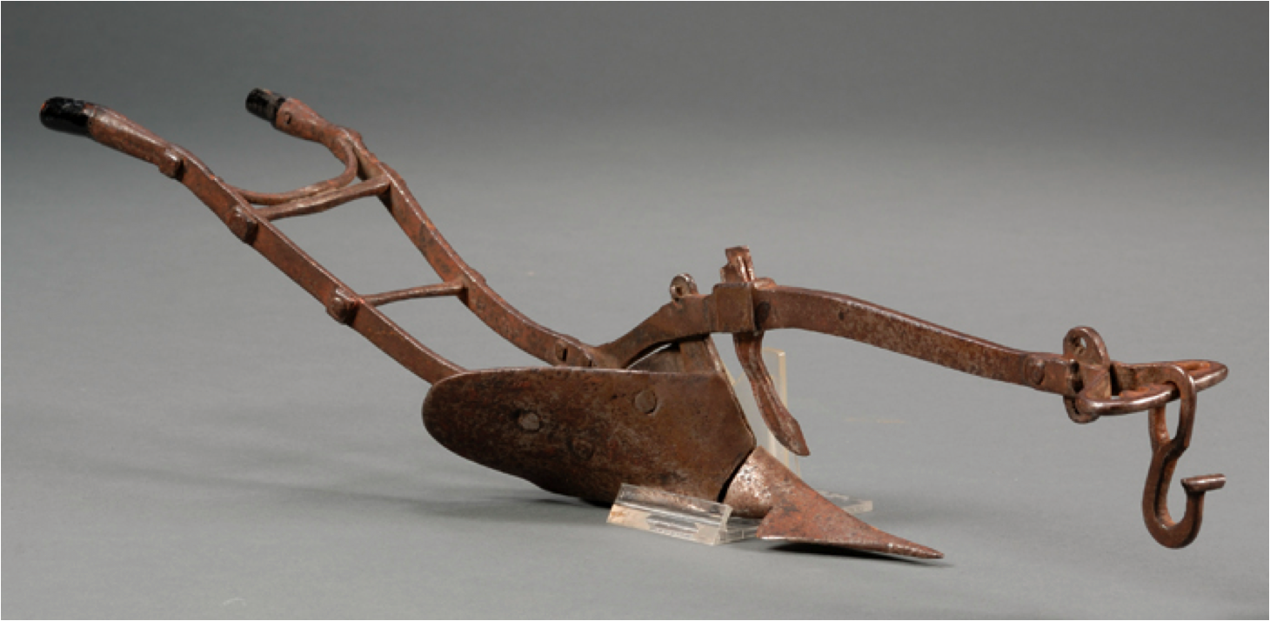
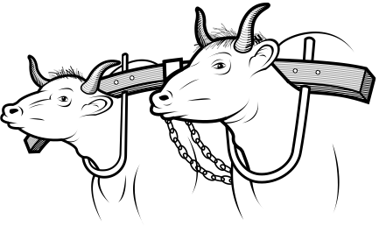
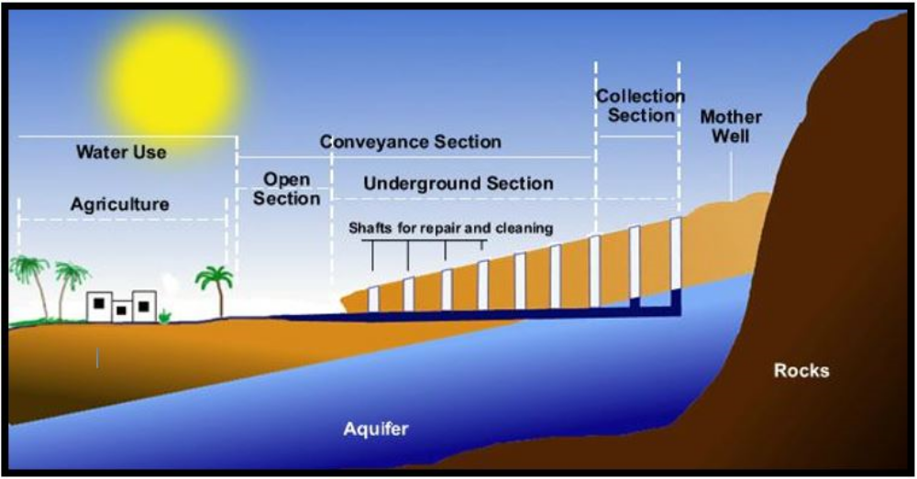
Farming technology
Plows
a piece of farm equipment that is used to dig into and turn over soil especially to prepare the soil for planting
Yokes
a wooden crosspiece that is fastened over the necks of two animals and attached to the plow or cart that they are to pull.
qanat system
a gently sloping underground channel or tunnel constructed to lead water from the interior of a hill to a village below.

Slide 9
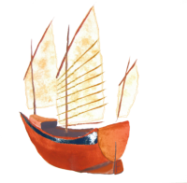
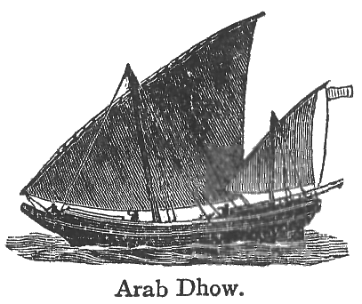
Maritime technology
When? Age of Exploration 1450-1750
Cartography
Map Making
Compass
Invented by Chinese, tells cardinal directions with a magnet
Astrolabe
Tells line of Latitude (How far north/south of equator)
lateen sail
Triangular shape sails used to manipulate wind patterns
Caravels (European) Junk (Chinese) dhow ships (Indians/Middle Easterners)
Used in early exploration – had NO engine, but used lateen sails paired with Astrolabes/maps to detect and control travel
Longships (Vikings) – c. 800s
NO STEAM OR ENGINES, JUST THE SAIL and RUDDER!

Slide 10
Technological innovations

Slide 11
Culture

Slide 12
Semite, Anti-Semitic
Semite: Jewish
Definition: Prejudice or discrimination against Jews Historical Significance: led to the Holocaust and other significant discrimination of the Jews throughout World History.

Slide 13
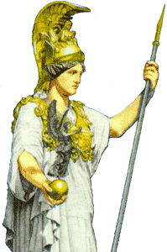
Greco-Roman Philosophy
Polytheistic
Homer’s the Illiad and the Odyssey, the family relationships between the numerous gods were explained.
Examples of these gods would be Zeus, the highest god; Poseidon, the god of the sea; and Ares, the god of war.
These gods have very human-like qualities. Homer had raised twelve gods over all other gods and housed them at Mount Olympus. While these gods could be viewed as cruel and selfish at times, they all had basic rules for good behavior.
Greek and Roman religion had no definite rules of “proper” behavior; in addition, there was no set of specific religious beliefs or principles to adhere to. Each civilian was able to determine how he or she was supposed to behave. The only requirement was to participate in the public’s official worship ceremonies.
Due to this unspiritual life, there were many opportunities to speculate what a good life meant and for how nature is constructed. Where religion had answered these questions in other cultures, Greco-Roman philosophy contributed to the discussion of these questions. Greco-Roman philosophy had created the basis for the future Western Philosophy and had been the central religious and philosophical system of the western world until the 5th century C.E. It was perceived as humanities first effort to presenting rational explanations for the workings for the world without mythological content or the operation of gods to explain existence.

Slide 14
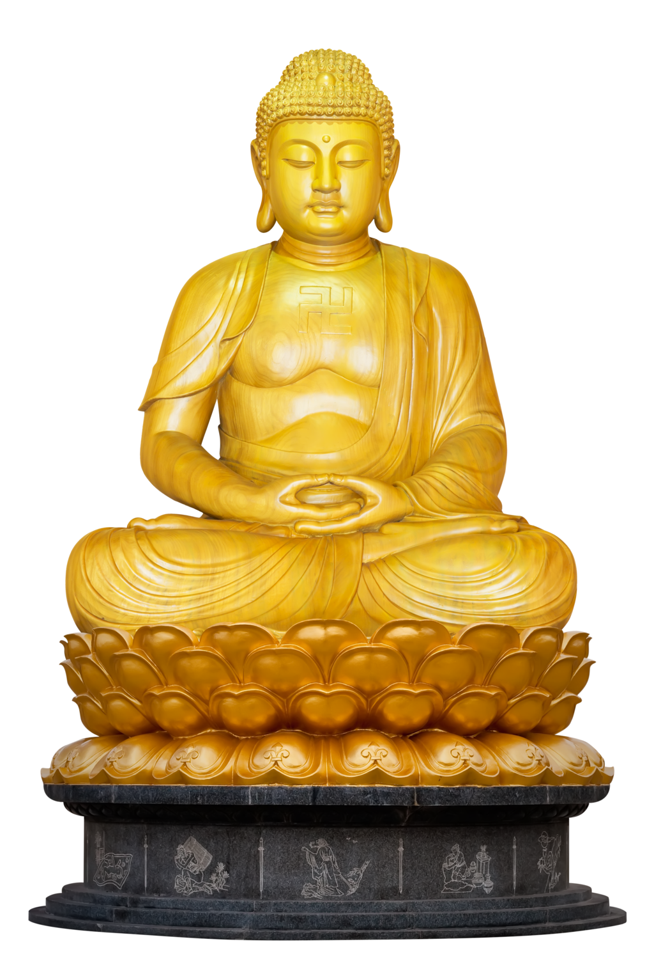
Asceticism
rigorous self-denial and active self-restraint; the doctrine that through renunciation of worldly pleasures it is possible to achieve a high spiritual or intellectual state; the trait of great self-denial (especially refraining from worldly pleasures)
Example: Buddha, Jainism

Slide 15
Shaman
Leaders of the Animistic Faiths
Primarily practiced in Central Asia in Mongolia and Siberia before Buddhism was brought to these areas, after which Shamanism began to become obsolete.
Shaman: the priest of the Shamanistic belief system.

Slide 16
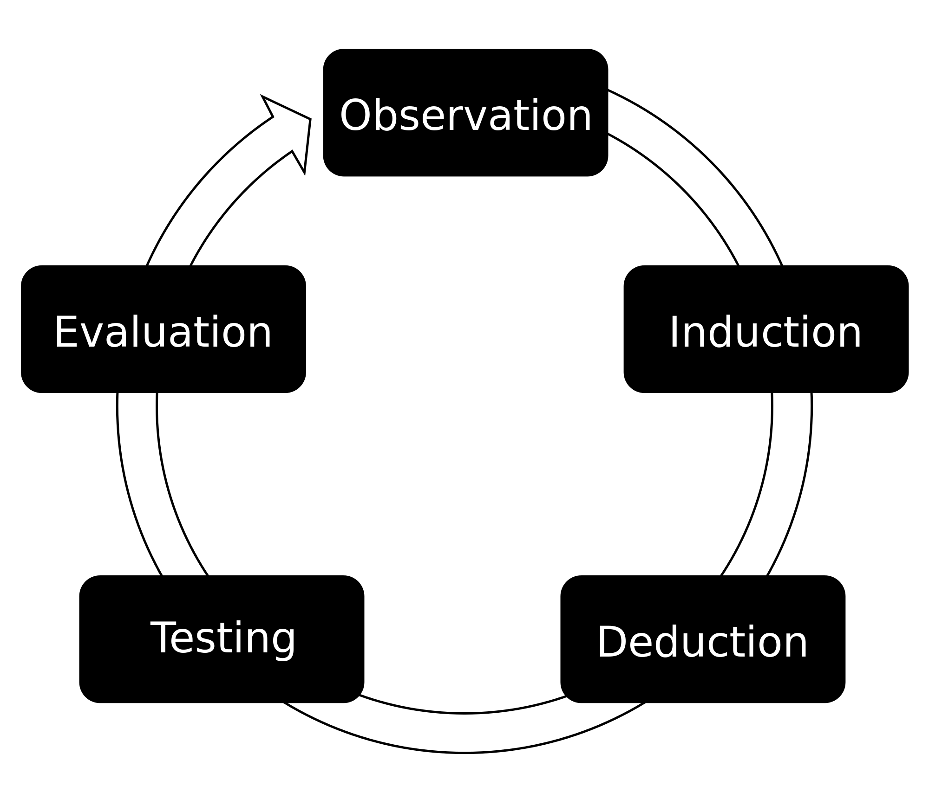
Empirical Observation
The core ideas in Greco-Roman philosophy and science emphasized logic, empirical observation and the nature of political power and hierarchy.
Evidence that is based upon objective observation, measurement, and/or experimentation.

Slide 17
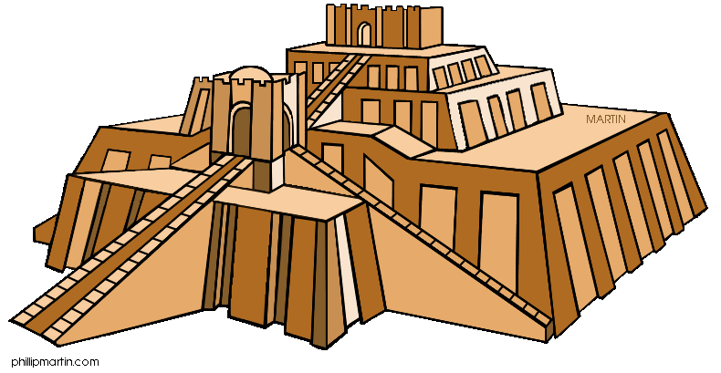
Monumental Architecture and Urban Planning
Pyramids
Egyptians
Ziggurats
Mesopotamians
Temples
Hindu/Buddhist Temples
American temples
Defensive walls
Byzantine Empires
Streets/roads
Romans/Incas
Sewage and water systems
Indus River Valley

Slide 18
Arts & Artisanship
Elaborate weaving
Inca
Painting
Renaissance
Sculpture
Renaissance
Buddhist sculptures (Empress Wu)
Wall decorations
Frescos in Roman Villas
Courtly literature
Middle Ages (European Knights and Chivalry)
Miniature paintings
Middle Ages Bibles in Europe
Renaissance art
Da Vinci, Michelangelo, Raphael, Donatello
Woodblock prints
China, Japan

Slide 19
Literature
Book of the Dead
Ancient Egypt
Rig Veda
Hinduism: Vedic Age
Epic of Gilgamesh
Mesopotamia
Popul Vuh
Creation story of the Mayans: http://www.criscenzo.com/jaguarsun/popolvuh.html
Confucius Analects
Warring States Period between Zhou and Han
Kabuki
Japan
Codices
Maya texts, long strips of paper, many meters in length when unfolded, made of the pounded inner bark of certain trees; these texts helped analysts interpret Maya hieroglyphics

